Slide 1
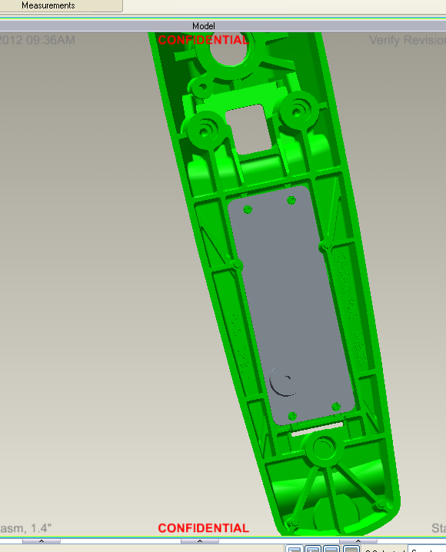
We have flexibility
in the connections for
power and the motor.
The keypad connection
is very constrained.
Motor and cutout for power
and CAN wires are in this
area.
Buzzer is just included
for height reference.
Disregard location and
spacing.
Slot for keypad wires is 19 mm
X 1.6 mm as shown

Slide 2
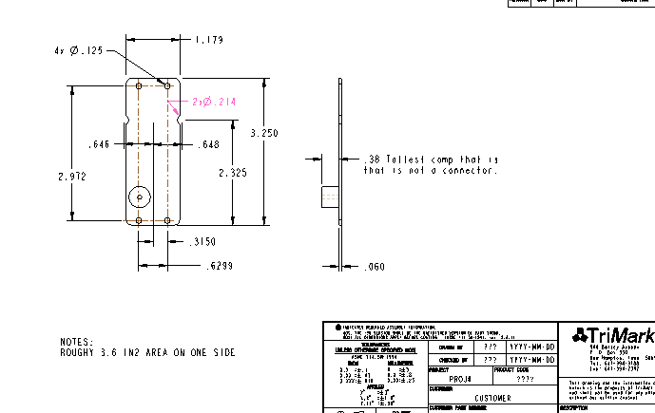
Circuit board allowed by spacing. This is all that is available.

Slide 3
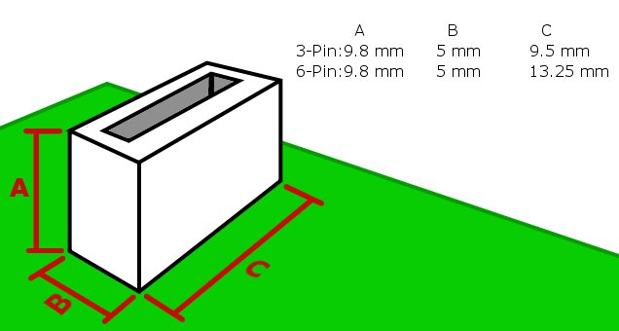
There are two tails that come from the keypad. These have 6-pin and 3-pin connectors.
The p/n’s are Molex: 39-53-2035 and 39-53-2065. The 3-pin connector will be on the
outside of the curve (need to be further up the board). Connectors need to be parallel
with the short side of the board.

