Slide 1
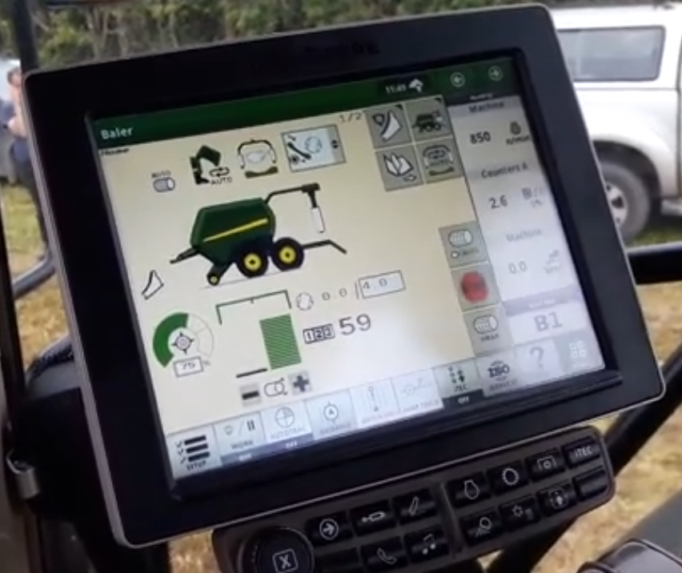
Cyber Tractor Challenge
Virtual Terminal and Lab
ISO11783-6 Tutorial and Lab Activity

Slide 2
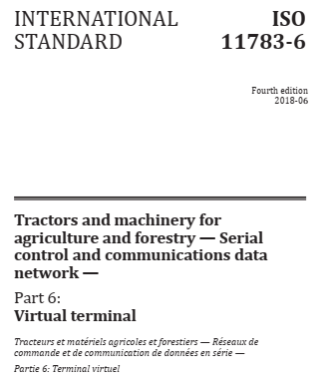
ISO 11783 – Virtual Terminal

Slide 3
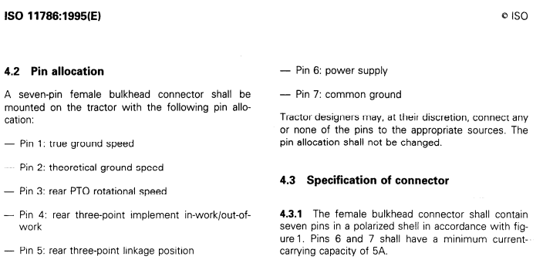
ISO 11786 – comic relief

Slide 4
Agenda
Purpose, History
How it Works
How Implements use it
What do VTs look like
VT Interactions – lab

Slide 5
Agenda
Purpose, History
How it Works
How Implements use it
What do VTs look like
VT Interactions – lab

Slide 6
Virtual Terminal – What is it?
ISO Definition
A virtual terminal (VT) is an electronic control unit (ECU), consisting of a graphical display and input functions, connected to an ISO 11783 network that provides the capability for an ECU, an implement or a group of implements to interact with an operator. The VT provides the capability to display information and to retrieve data from an operator. An ECU, an implement or a group of implements represented by a Working Set Master acquires storage for objects within the VT and on demand displays this stored information to an operator. In this part of ISO 11783, the term working set will be used for an ECU, an implement or a group of implements either represented by a single ECU or a group of ECUs acting as a working set. Working sets on the network can also acquire the use of input and control keys of the VT to allow the operator to send signals back to the working set.
Notes:
What’s a VT? Here’s the ISO definition.
In simpler terms, <CLICK TO ADVANCE>

Slide 7
Virtual Terminal Defined
A Virtual Terminal (VT) is the device that provides:
the human to machine interface
that enables interaction between the operator and the machine.
A VT is like a web browser in concept. Slightly reversed, the many ECUs/Working Sets(WS) publish to the VT on the ISO 11783 (“ISOBUS”).
Just as with the web browser, the VT does not know what is being presented on the screen, it only knows the rules that govern how that presentation appears.
VT
…
WS 1
WS 2
WS 3
WS n
Notes:
It is the human to machine interface to enable interaction between the operator and the machine.

Slide 8
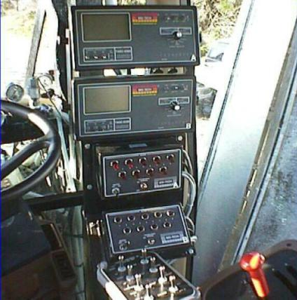
Virtual Terminal – the Goal
Reuse one display
rather than one or more
for each implement.
Additionally
VT Auxiliary Control permits
many of the independent switches and knobs to be reused as well.

Slide 9
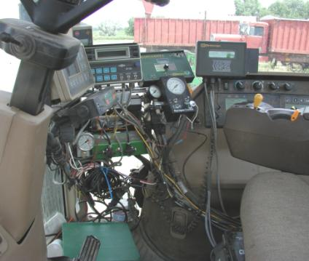
Virtual Terminal – the Goal
Also, to try to avoid this…

Slide 10
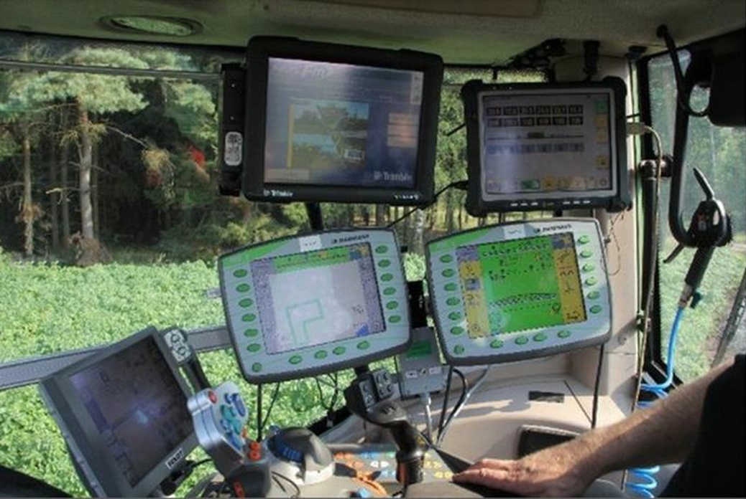
Virtual Terminal – the Goal
but now, we see, this …
Notes:
How many of you have two screens on your computer?

Slide 11
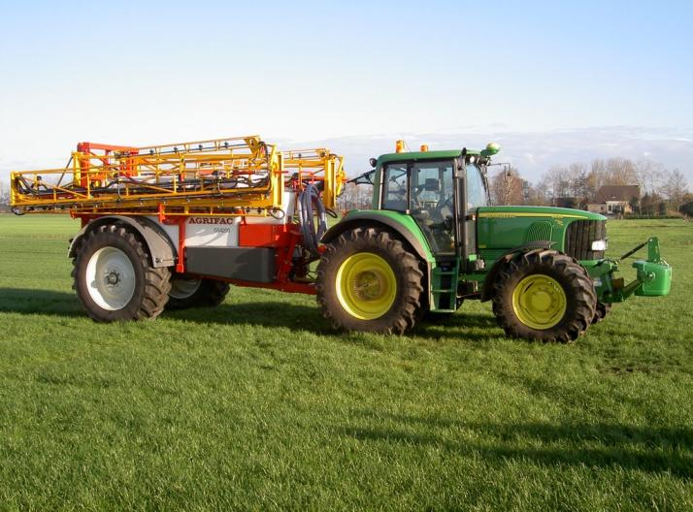
Virtual Terminal – the Goal
Notes:
What does a VT do? It permits the reuse of human machine interface.

Slide 12
Historical Review – VTv1
~1998
  Work started on defining VT
  People from many companies were involved
  Leveraged concepts from a less successful LBS standard
2001
  A “version 1” draft of the standard stabilized
  Development was well underway at many companies
2001 Agritechnica
  First VTs on display
Work on the standard did not slow down with these first “prototypes”…

Slide 13
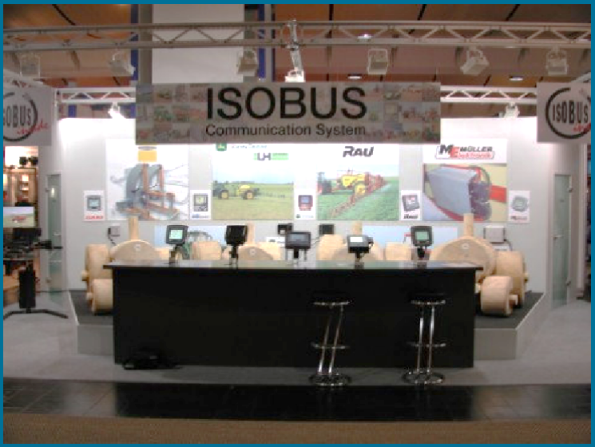
History – Agritechnica 2001

Slide 14
Historical Review – VTv1 Results
Successes:
  Transferring a User Interface definition across CAN
  Leveraging
    Either color or black and white graphics
    With or without Touch Screen
  Manufacturer Independent User Interface
    Supports either frugal or high-end display technology
  Multi-manufacturer Participation
  Actual Presentation
    Reasonably accurately represented what was delivered
Demonstrated the need to refine the specification

Slide 15
Historical Review – VTv2
2004
  Work continued from 2001
    Add capabilities / interactions
    Resolve identified incompatibilities
  ISO11783-6:2004
  Published as an International Standard

Slide 16
Historical Review – VTv2 Results
Successes:
  Industry Level Success in Customer Hands
    Many companies have produced VTs
    Many companies have produced compatible Implements
Challenges:
  Specification was not “precise” enough for all readers
  Led to some incompatibilities
Demonstrated the need to further refine the specification

Slide 17
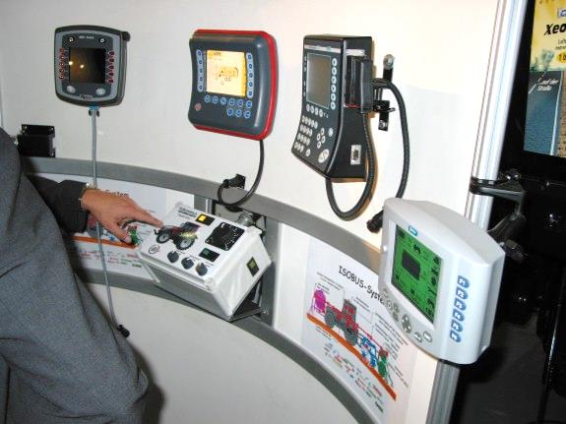
History – Agritechnica 2003

Slide 18
VT Version 3/4
2006
  Task Force commissioned
  VT Version 3 Features
    Replaces VTv2 Auxiliary Controls
  VT Version 4 Features
    Support Additional Regions (Languages)
    Enhance for Precision Farming
    Clarify (~600) Issues that Led to Incompatibilities
2010
  Combined versions released as one document
  ISO11783-6:2010

Slide 19
Historical Review – VTv3/4 Results
Successes:
  Industry Level Success in Customer Hands
    Many companies have produced VTs
    Many companies have produced compatible Implements
Challenges:
  Getting to Market Fast Enough (addressing the 600 comments)
  ISO11783-14 starts development
    Requires new capabilities in the VT beyond VTv4
Part 14 requires New Features in VT. The work continued…

Slide 20
VT Version 5
2010
  Task Force work starts
  Features
    Support for Sequence Control (ISO11783-14)
    Clarify Issues (quite a minor list)
2014
  ISO11783-6:2014
    Ballot approved in January 2014
    ~ 110 comments
Challenges:
  Addressing the comments quickly
  Addressing technical issues
Ballot was a topic for discussion earlier this week at TC23/SC19/WG1 Meeting…

Slide 21
History – VT Versions
Versions
  SAE J1939:~1988 (Work began)
  ISO11783-6:1998 (VT work began)
  ISO11783-6:2001 (VTv1 – DRAFT)
  ISO11783-6:2004 (VTv2)
  ISO11783-6:2010 (VTv3, VTv4)
  ISO11783-6:2014 (VTv5)
  ISO11783-6:2018 (VT Version 6)
  ISO11783-6:2025 (VT Version 7)

Slide 22
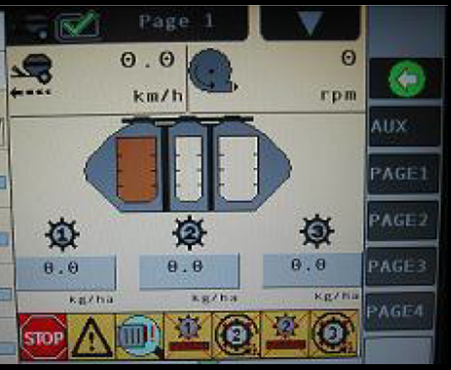
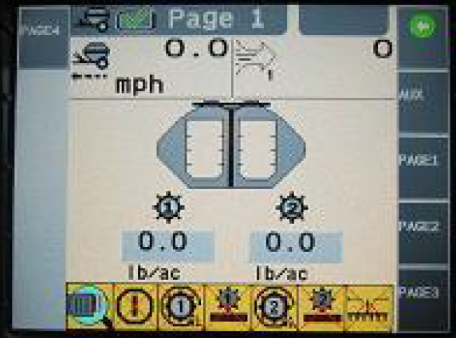
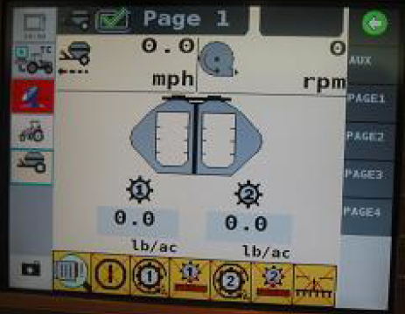
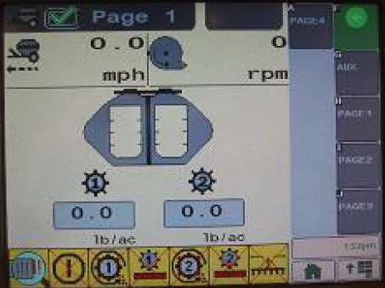
VT – Manufacturer Interoperable
CNH
AGCO
JOHN DEERE
KVERNELAND

Slide 23

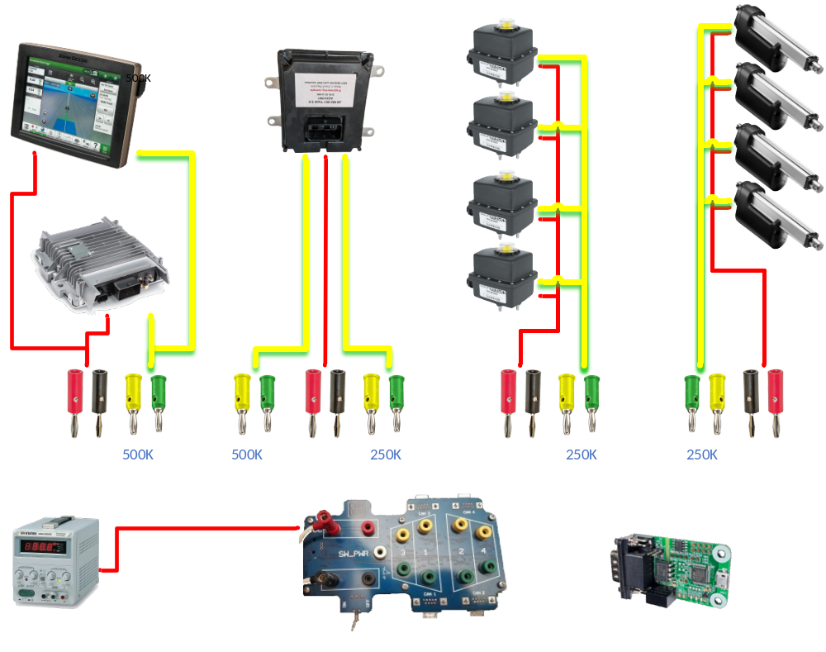
Lab Action – Monitor Network Traffic
John Deere – Lab setup
CAN Bus Speeds: 250K and 500K

Slide 24
Lab Action – Find the VT
Find the VT Application
Find its menu of VT Clients
Look at each and Explore

Slide 25
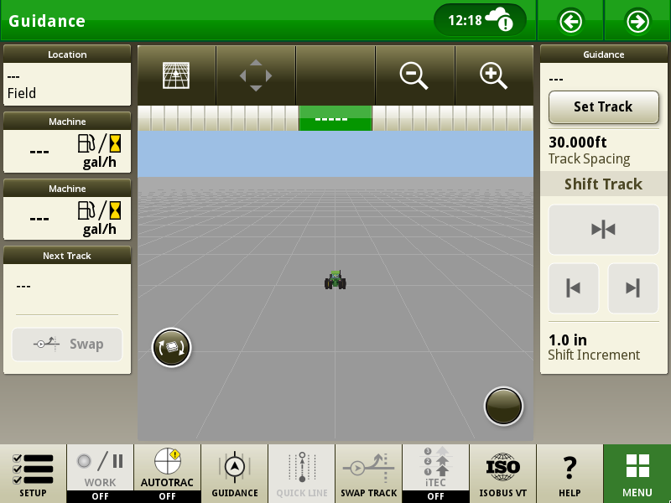
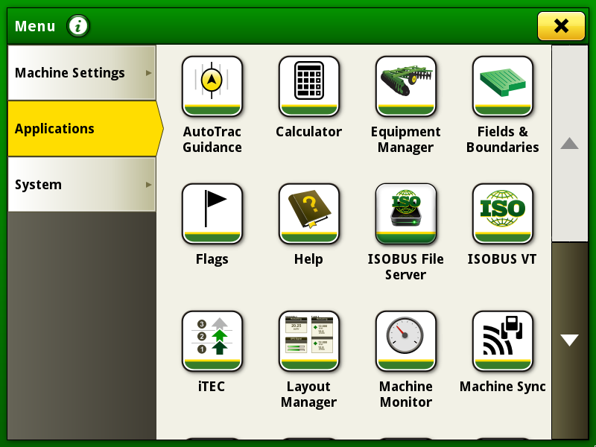
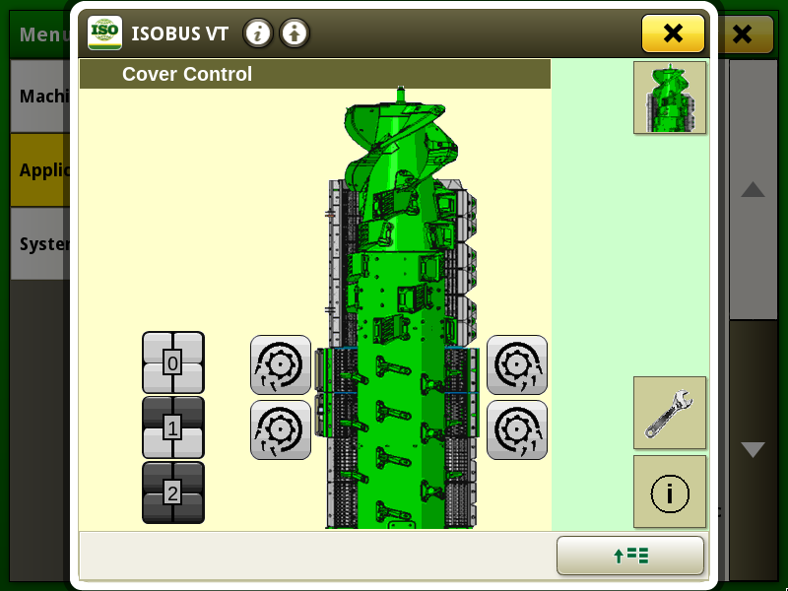
Lab Action – Find the VT
John Deere – Lab setup

Slide 26
Agenda
Purpose, History
How it Works
How Implements use it
What do VTs look like
VT Interactions – lab

Slide 27


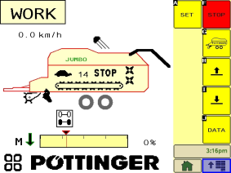
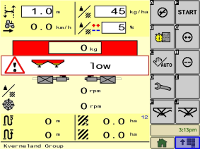

VT – Some Terminology
Virtual Terminal (definition already shown)
Working Set A Working Set (WS) is an implement, or a group of implements represented by a single ECU or group of ECUs
Virtual Implement A (VI) is another name for a Working Set, or client of a VT. VI is not defined by ISO but appears in this PPT.
Object Pool A collection of objects that completely define the operator interface for a single working set. The complete VT definition will be made up of one or more Object Pools, one for each working set.
VT Objects Smallest object in the Object Pool
Notes:
Graphic is from Kverneland implement ECU.

Slide 28

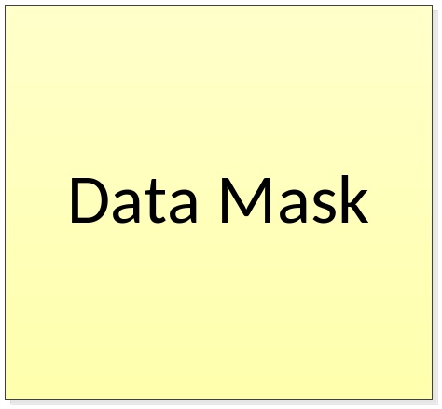


Virtual Terminal – Overview
Key
Soft Key Mask

Slide 29
VT – 31 Objects (:2004)
Working Set Object
Data Mask Object
Alarm Mask Object
Container Object
Soft Key Mask & Keys
Input Field Objects
Output Field Objects
Window Mask Object
Key Group Object
Output List
Graphic Context Object
Output Shape Objects
Picture Graphic Object
Variable Objects
Attribute Objects
Pointer Object
Macro Object
Auxiliary Type 1 Objects
Auxiliary Type 2 Objects
Color Map Object
Object Label Reference
External Object *
Animation Object
Notes:
Above the line represent the 31 objects from VTv2 (ISO11783-6:2004)
Below the line represent the additional objects from VTv3, v4 (ISO11783-6:2010) and v5 (ISO11783-6:2013?)

Slide 30
VT – 43 Objects (:2010)
Working Set Object
Data Mask Object
Alarm Mask Object
Container Object
Soft Key Mask & Keys
Input Field Objects
Output Field Objects
Window Mask Object
Key Group Object
Output List
Graphic Context Object
Output Shape Objects
Picture Graphic Object
Variable Objects
Attribute Objects
Pointer Object
Macro Object
Auxiliary Type 1 Objects
Auxiliary Type 2 Objects
Color Map Object
Object Label Reference
Notes:
Above the line represent the 31 objects from VTv2 (ISO11783-6:2004)
Below the line represent the additional objects from VTv3, v4 (ISO11783-6:2010) and v5 (ISO11783-6:2013?)

Slide 31
VT – 45 Objects (:2014)
Working Set Object
Data Mask Object
Alarm Mask Object
Container Object
Soft Key Mask & Keys
Input Field Objects
Output Field Objects
Window Mask Object
Key Group Object
Output List
Graphic Context Object
Output Shape Objects
Picture Graphic Object
Variable Objects
Attribute Objects
Pointer Object
Macro Object
Auxiliary Type 1 Objects
Auxiliary Type 2 Objects
Color Map Object
Object Label Reference
External Object
Animation Object
Notes:
Above the line represent the 31 objects from VTv2 (ISO11783-6:2004)
Below the line represent the additional objects from VTv3, v4 (ISO11783-6:2010) and v5 (ISO11783-6:2013?)

Slide 32
VT – 49 Objects (:2018)
Working Set object
Data Mask object
Alarm Mask object
Container object
Window Mask object
Soft Key Mask object
Key object
Button object
Key Group object
Input Boolean object
Input String object
Input Number object
Input List object
Output String object
Output Number object
Output List object
Output Line object
Output Rectangle object
Output Ellipse object
Output Polygon object
Output Meter object
Output Linear Bar Graph object
Output Arched Bar Graph object
Picture Graphic object
Graphics Context object
Number Variable object
String Variable object
Font Attributes object
Line Attributes object
Fill Attributes object
Input Attributes object
Extended Input Attributes object
Object Pointer object
Object Label Reference List object
External Object Definition object
External Reference NAME object
External Object Pointer object
Animation object
Macro object
Color Map object
Auxiliary Function Type 1 object
Auxiliary Input Type 1 object
Auxiliary Function Type 2 object
Auxiliary Input Type 2 object
Auxiliary Control Designator Type 2 Object Pointer
Color Palette object
Graphic Data object
Working Set Special Controls object

Slide 33
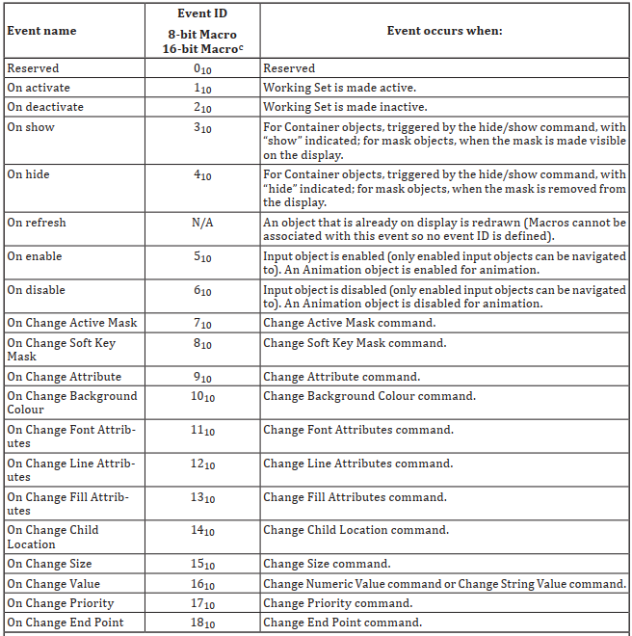
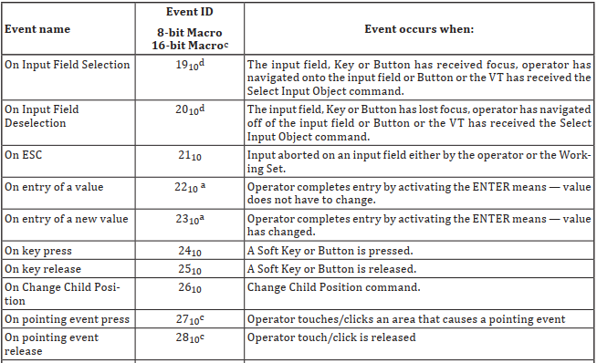
VT – 28+ Events (for Macros)

Slide 34
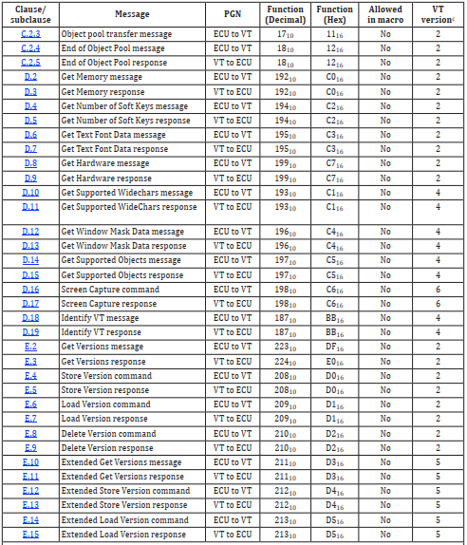
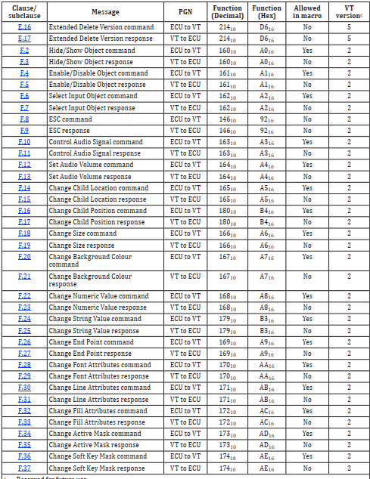
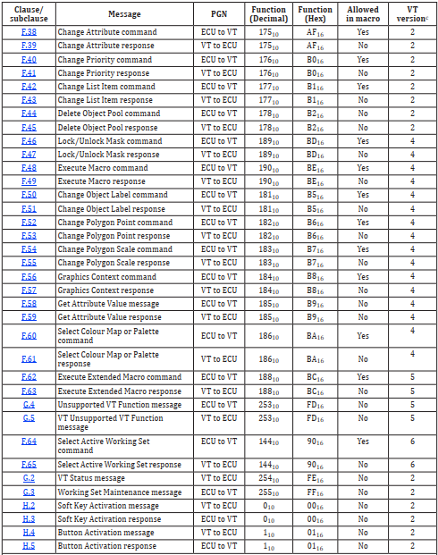
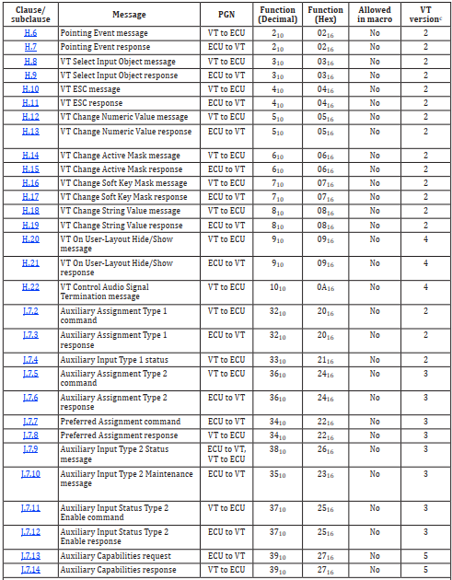
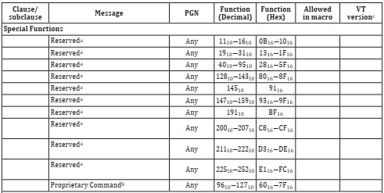
VT – 64+ Commands

Slide 35
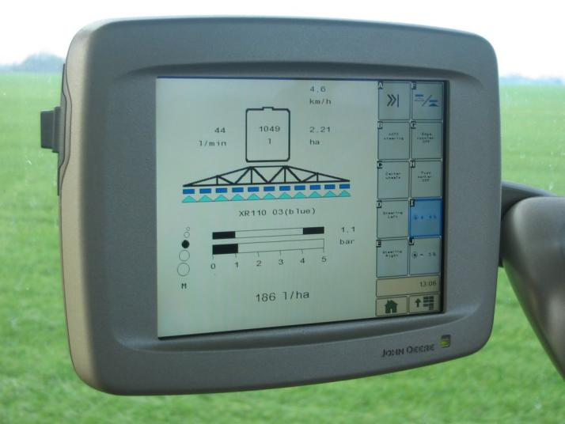
Virtual Terminal – Presentation
Key
Polygons, Lines, Bitmaps
Bar Graph
Ellipse, Bitmaps
Numbers
Text
Notes:
Here’s a screen from a sprayer that presents several of the possible elements in the user interface.
The VT protocol was designed based on the limited bandwidth available on CAN. In spite of that, it can do some very amazing things, and can support a very rich presentation and interaction. Even limited animation is possible.
Image courtesy Spraying Systems.

Slide 36
Agenda
Purpose, History
How it Works
How Implements use it
What do VTs look like
VT Interactions – lab

Slide 37
Developer Perspective
Object Pool Construction
  Ex. Definition of a Data Mask
Authoring Tools
Implantation Into a Controller
Communication with VT

Slide 38
Object Hierarchy
Parent Object can have 0 to 255 Child Objects
Many Child Objects can be a Parent Object
Objects can be “reused” for efficiency
Data Mask
Container
Container
Circle
Button
Container
Rectangle
Circle
List
Image 1
Image 2
Text Item
Rectangle
Image 1

Slide 39
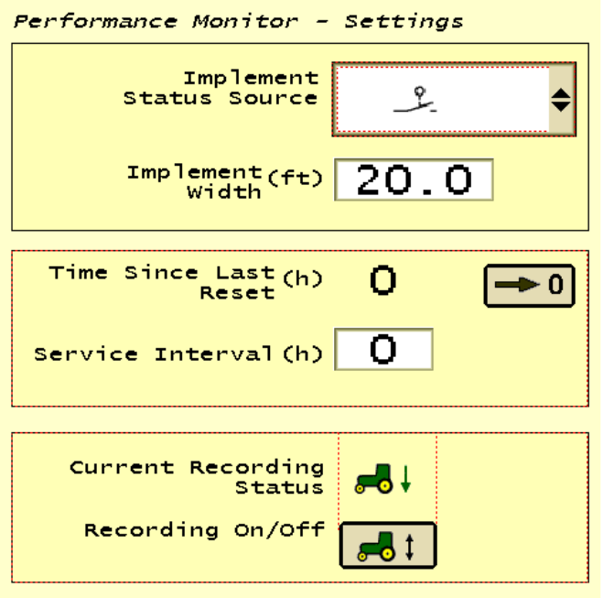






Object - Hierarchy
Performance Monitor - Settings
Implement
Status Source
Implement
Width
(ft)
Time Since Last
Reset
(h)
Service Interval
(h)
Current Recording
Status
Recording On/Off

Slide 40
Object Pool Construction
Object ID
Type – Data Mask
Background Color
Soft key Mask
# Obj to Follow
# Macros to Follow
Obj ID
X Location
Y Location
Macro Event ID
Macro Obj ID
[2]
[1]
[1]
[2]
[1]
[1]
[2]
[2]
[2]
[1]
[1]
00 10
01
34
34 12
01
00
01 20
40 00
40 00
Object ID
Type – Line
Line Attributes
Width
Height
Line Direction
# Macros to Follow
Macro Event ID
Macro Obj ID
[2] 01 20
[1] 0D
[2] 02 20
[2] 80 00
[2] 40 00
[1] 00
[1] 00
[1]
[1]
Notes:
But how do we define a presentation? This is getting into some deep details.
Each Object is uniquely identifiable. This is necessary for design, and for run-time manipulation. Here, we see a data mask.
We’ll define the color and place another object (a line) on it.
As you see, the Data Mask has references to the Line Object
The Line Object has attributes for drawing the line.
This simple set of relationship can be extended to a pool with 1000’s of objects and interactions.

Slide 41
Object Pool Construction
In Object Pool:
Data Mask
Crop
Corn
Yield Dry
185
Container
Yield Wet
210
Moisture - Field
12%
Rectangle #101
Flags On
1,3
Rectangle #102
Text #105
Text #106
Text #…
Output Field #233
Output Field #234
Output Field #…

Slide 42
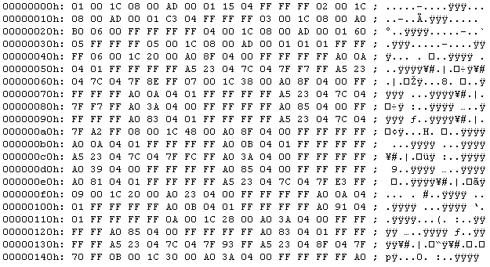
Authoring a User Interface
01 00 1C 08 00 AD 00 01 15 04 FF FF FF 02 00 1C
08 00 AD 00 01 C3 04 FF FF FF 03 00 1C 08 00 A0
IOP
Notes:
So, these things called Object Pools are a bunch of pretty tightly compressed streams of binary. One way to create these things is <Advance>. And eventually, you get <Advance> a pool. But good luck debugging it.
All this stuff gets packed into one or more “files”. The industry has mostly settled on IOP (ISOBUS Object Pool) for the file format. There is no required file format, but from the definition of the pool, this is the natural outcome.

Slide 43
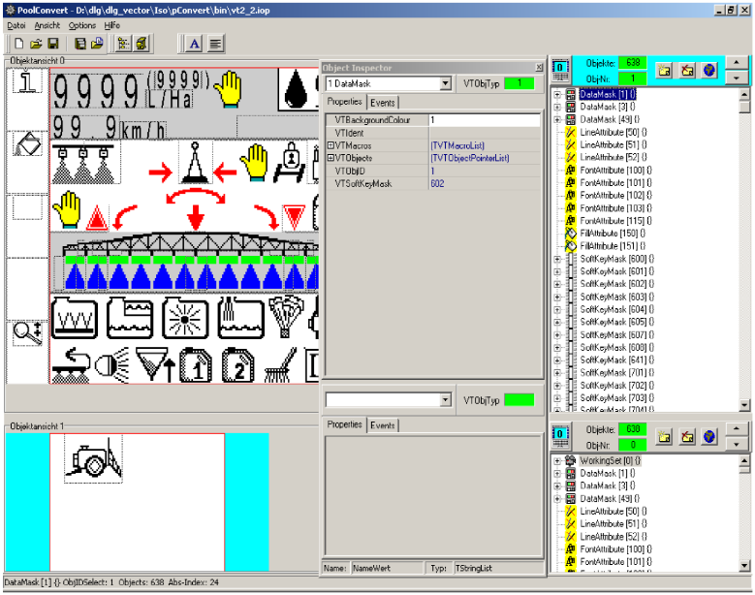
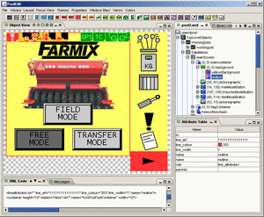
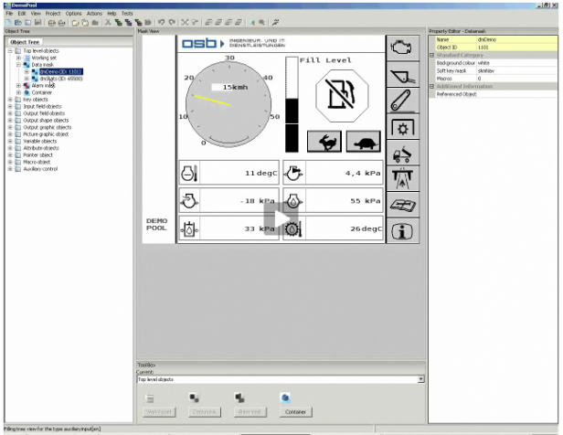
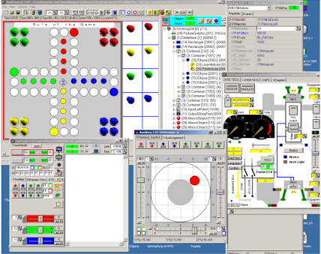
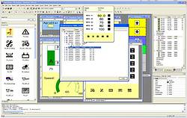
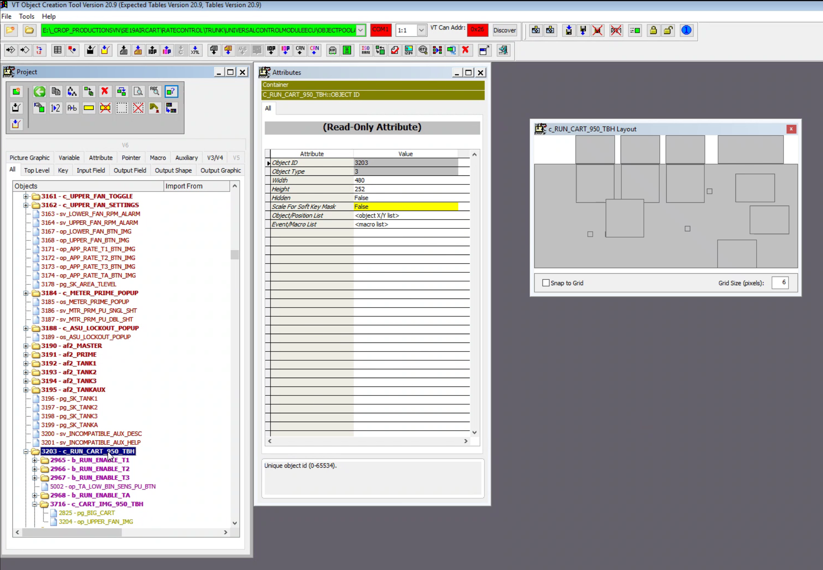
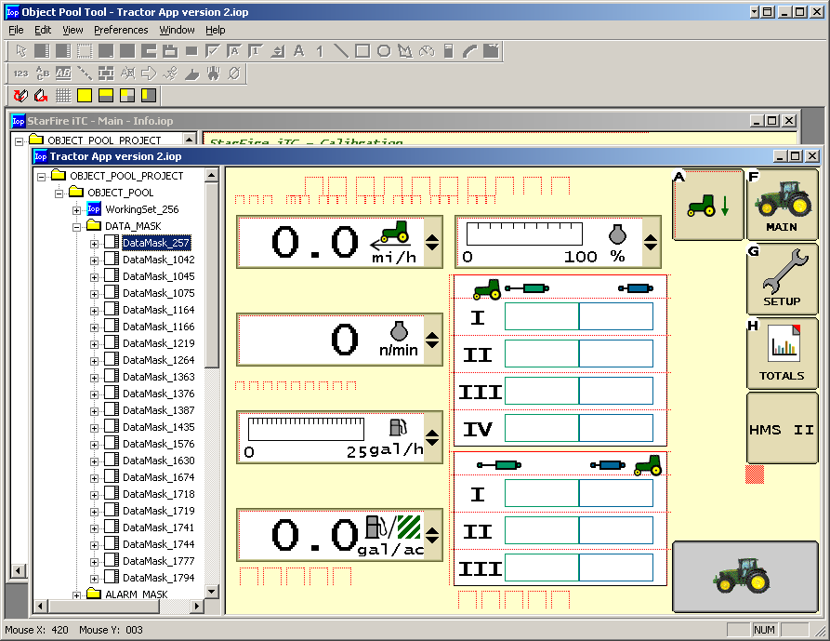
Authoring Tools
WTK: Mask Generator
Farmix: PoolEdit
OSB: VT Designer
DLG: pConvert
Jetter: ISO-designer
CNH: VT Object Creation
JD: JDGUI-Design
Notes:
There are commercial and open-source tool for creating the object pools. Some other companies have their own proprietary version as well.
WTK: Mask Generator – http://www.wtk-elektronik.de/fileadmin/pdf/Prospekt_MaskGenerator_web.pdf
Farmix: PoolEdit – http://autsys.tkk.fi/en/Farmix/PoolEdit
OSB: VT designer – http://vt-designer.com/
DLG: pConvert – originally designed for testing of VTs, was never designed for development purposes.
Jetter: ISO-designer – https://www.jetter.de/en/products/software/iso-designer.html?l=5
CNH: <Proprietary Design Tool> VT Object Creation Tool
JD: <Proprietary Design Tool> JDGUI-Design

Slide 44
Authoring Tools - JDGUI-Design

Slide 45
Publishing to a VT
We need an ECU
We need it to host an Object Pool
We need it send the Pool to a VT
We need it to interact with the VT

Slide 46
Implantation Into a Controller
// Operating Sys.
IOP
// Application.c
Compiler
// myPool.c
char Pool[] =
{
0x12, 0x01, …
0x34, 0x00, …
0x10, 0x80, …
0x30, 0xB3, …
0x0D, 0x8A, …
};
Pool to Code
Converter
Programming
Tool
Hex File for
Programming
Notes:
There are many ways, and this shows only one possibility.

Slide 47
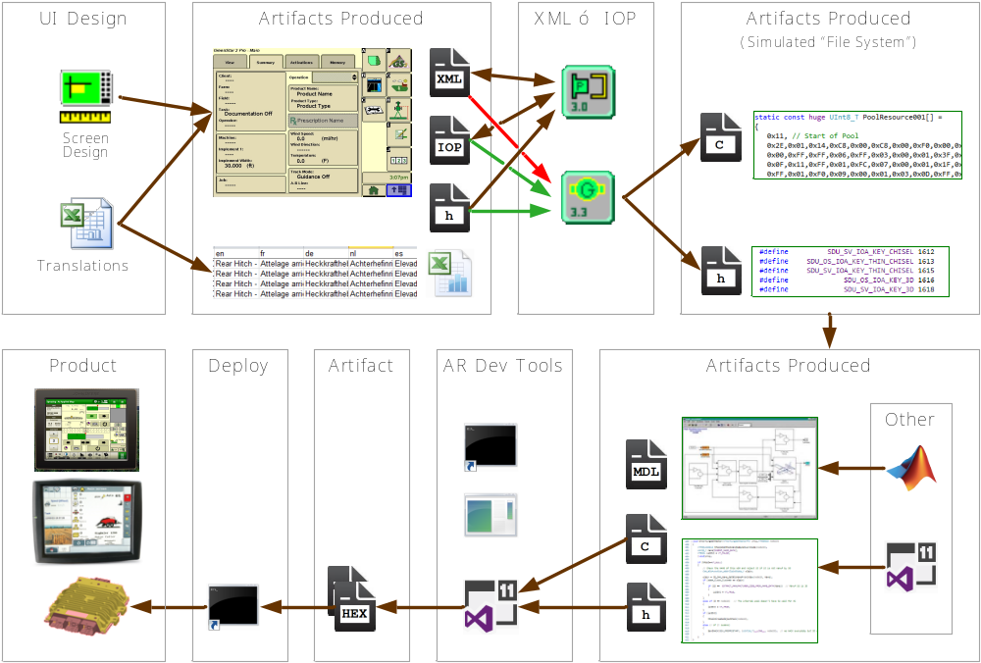
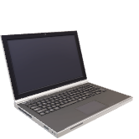
Notes:
A bit more detailed and showing other steps in the cycle.
This is the JD work-flow, but it is similar to that of other companies.

Slide 48
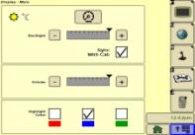
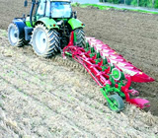

Embedded System - Software
Virtual Terminal
Implement
VT Application
For Presentation
VI Application
For Presentation
IOP
VT Engine
VI Engine
ISO 11783
Protocol Stack
ISO 11783
Protocol Stack
Notes:
Conceptually, the VT and the Implement are symmetrical.
Each has an “Application” – [Note the non-ISO term “VI”, which stands for Virtual Implement. So named to be an easy to remember counter-part to the VT]
The VT Application renders the screens and accepts input from the operator
The VI Application provides the business logic to make the implement do what it needs to do
isoAgLib is an “open source” implementation of the software for implements (VIs).

Slide 49
Example Embedded OS
Application
Component 1
Application
Component 2
...
...
...
...
Application
Component N
UI Logic
Object Pool
Task Management
VI Engine
File System Driver
Data Repository
Power Management
Timing Management
Analog Input
Logic Input
Power Driver
Specialty I/O Drivers
Non-Volatile Memory
Network Comm
Fault Management
Diagnostics
Manufacturer Test
Re-Programming
Transport Prot.
Extended T.P.
Notes:
Whether an implement has a full-blown RTOS or not, there are various device drivers (bottom layer).
The yellow boxes are what is “unique” for ISO11783 and Virtual Terminal support.
The Object Pool and Data Masks (visualization), are for the first time separated from the implementation (code).
In support of this is the virtual implement driver, and extended transport protocol, in order to pass this information to the VT.

Slide 50
VT to VI Communication
VT
VI
VT Status (Here I am)
Detect VT
Query Metrics
Select
Resources
Scale
Presentation
Change
Color
Select
Language
Maintain
Heartbeat
B&W DataMasks
Get Hardware, …
“Great, What can you do?”
Color DataMasks
Responses…
Language: English, Screen: Color 480x480, Softkeys: 10 …
B&W Softkeys
123.4
Color Softkeys
Here’s my Object Pool
French Text
Set Object #24 Value to 123.4
German Text
Show DataMask #2
English Text

Slide 51
VT to VI Communication
VT
VIs
123.4

Slide 52
Decode an Object Pool
Files on the laptop
racc.log - can log of pool transfer
pool.iop - binary extract
pool.xml - xml decode

Slide 53
Lab Activity – Find this in the XML
How Many Data Masks
in this project? ________
For Data Mask 10360:
  How many child objects? _________
For Data Mask 10103:
  Background color? _________
For Input Number 10310:
  Min and Max value? _________
Notes:
11
4
230
FF, FF, CC
50, 100

Slide 54
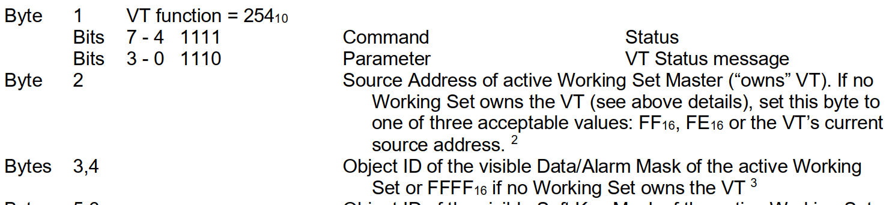
Lab Activity – Live Monitor
Filtering VT to ECU: VT Status
PGN: 0E600, VT Function FE
Active Source Address _________
Visible Data Mask ______________

Slide 55
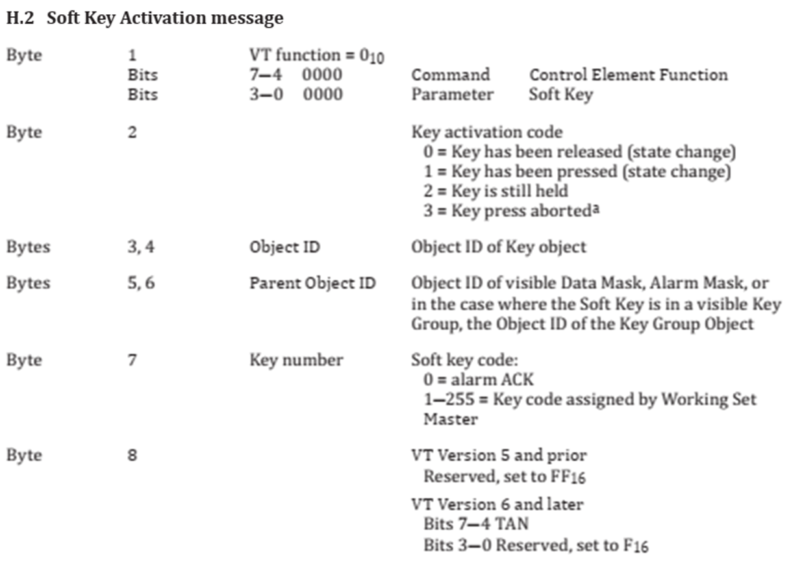
VT Commands: Keys/Buttons
Byte \ Cmd | Soft Key Activation | Button Activation
1 (VT Func) | 0x00 | 0x01
2 | Key Code | Key Code
3 | Object ID of this Key | Object ID of this Button
4
5 | Parent Obj ID | Parent Obj ID
6
7 | Key Number | Key Number
8 | 0xFF | 0xFF
1₁₀ Button Activation
Key Code
0 = Released, 1 = Pressed, 2 = Held, 3 = abort
Key Number
User definable num 0 - FF

Slide 56
VT Commands: Keys/Buttons
VT
ECU
VT to ECU
1CE68026 : 00 40 02 E8 03 01 FF FF
Priority 6, to address 80 from 26
Soft Key, 0x0240, on Data Mask 0x03E8, Press
VT to ECU
1CE68026 : 00 40 02 E8 03 00 FF FF
Priority 6, to address 80 from 26
Soft Key, 0x0240, on Data Mask 0x03E8, Release

Slide 57
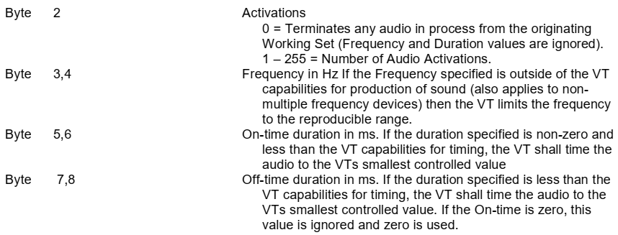
VT Command: Control Audio

Slide 58
Lab Action: Can you make a Beep?
HINT: cansend can0 18E72680#<data>

Slide 59
Lab Action: Make a Beep - ANSWER
Send this:
18E72680 : A3 02 E8 03 00 01 00 01
Freq.
(Hz)
On Time
(ms)
2 Beeps
Off Time
(ms)
Control Audio

Slide 60
With a little more effort…
Link to a small symphony

Slide 61
Agenda
Purpose, History
How it Works
How Implements use it
What do VTs look like
VT Interactions – lab

Slide 62
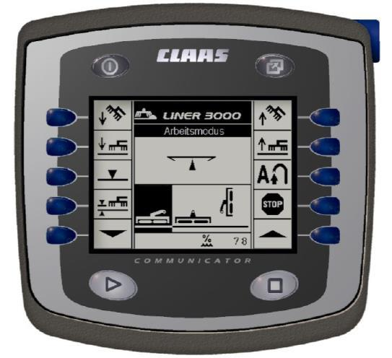
Data Mask
Soft Key Mask
[Hard] Keys

Slide 63
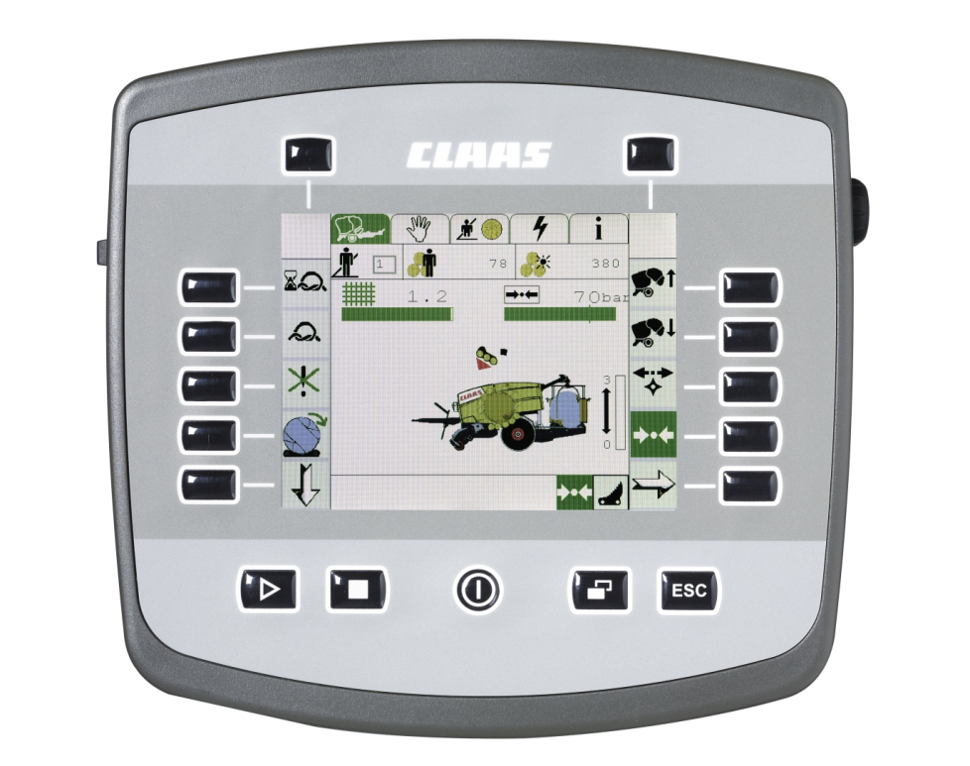

Slide 64
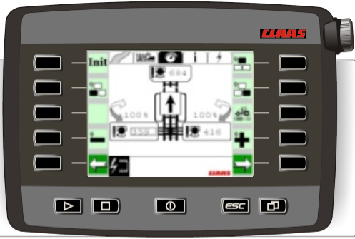

Slide 65
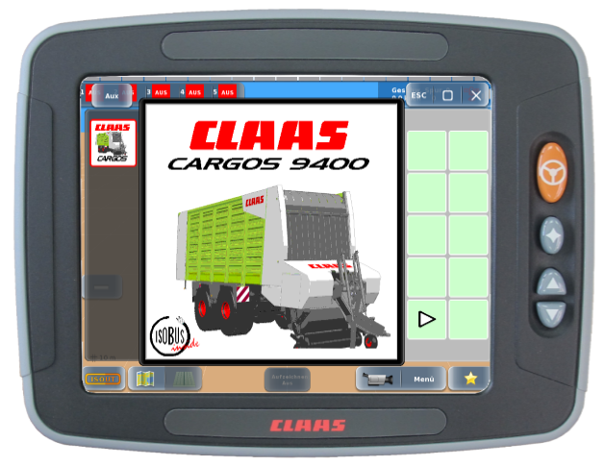

Slide 66
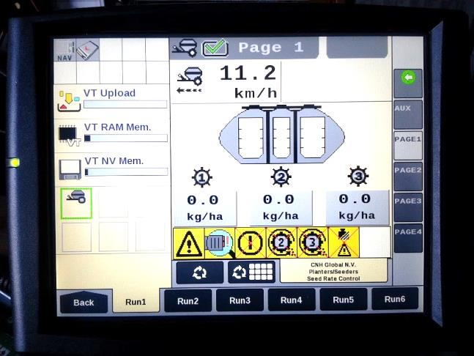

Slide 67
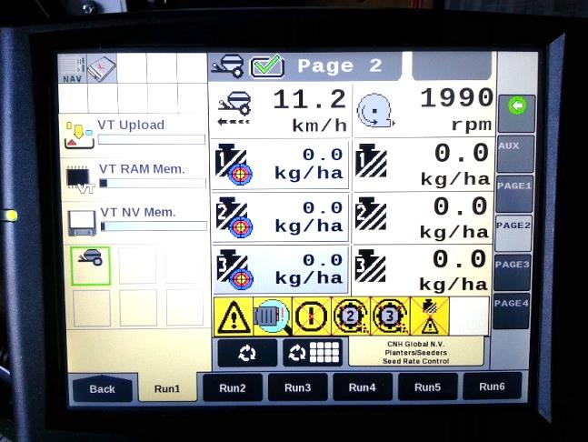

Slide 68


Slide 69


Slide 70


Slide 71


Slide 72


Slide 73


Slide 74


Slide 75


Slide 76




Slide 77




Slide 78
Virtual Terminal - Summary
Notes:
What does a VT do? It permits the reuse of human machine interface.

Slide 79
Questions and Answers
Check the Parking Lot for Questions
Open Q & A
Hands-on Lab Next

Slide 80
More Lab Fun ---
Purpose, History
How it Works
How Implements use it
What do VTs look like
VT Interactions – lab

Slide 81

A few ECU to VT Commands
Byte \ Cmd | Change Numeric Value | Change Attribute
1 (VT Func) | 0xA8 | 0xAF
2 | Obj ID of Obj to change | Obj ID of Obj to change
3
4 | 0xFF | AID of Attr
5 | New Value | New Value
6
7
8
Key Code
0 = Released, 1 = Pressed, 2 = Held, 3 = abort
Key Number
User definable num 0 - FF

Slide 82
VT Commands: Change Num Val
ECU
VT
ECU to VT
18E72680 : A8 37 04 FF 78 56 01 00
Priority 6, ECU to VT, to address 26 from 80
Change Numeric Value,
of Object 0x0437,
to 0x00015678
VT to ECU
18E68026 : A8 37 04 00 78 56 01 00
Priority 6, VT to ECU, to address 80 from 26
Change Numeric Value Response,
of Object 0x0437, no errors,
to value 0x00015678

Slide 83

Input Number Obj – Attributes

Slide 84

Input Number Obj – Attributes

Slide 85


VT Command Summary

Slide 86


VT Command Summary

Slide 87

VT Command Summary

Slide 88

And that was
the tip
of the Iceberg

Slide 89
On the laptop
CTC Virtual Terminal and Lab.pptx
  This presentation
racc.log
  CAN log of the ECU and VT
pool.xml
  Extract of the Pool transfer from the log
VT Command Map.xlsx
  Handy resource (see next slide)

Slide 90

VT Command Map.xlsx
ECU to VT
ECU
VT
18E72680 : A8 37 04 FF 78 56 01 00

Slide 91
Cyber Tractor Challenge
Can you change something on the screen?
  Value, Text, Color, Location, Data Mask, or more…
Can you spoof the ECU and send it a command?
  Causing it to update the VT to confirm your command…

Slide 92
Lab Action (Bonus time)
Monitor the network, filtering for:
  ECU to VT (PGN: 0xE700)
    To VT Addr from ECU Addr
    Identifier: 0x1CE72680
  VT to ECU (PGN: 0xE600)
    To ECU Addr from VT Addr
    To Global Addr from VT Addr
    Identifier: 0x1CE68026
  Request Language (PGN: 0xEA00)
    To VT Addr from ECU Addr, To Global Addr
    Identifier: 0x0CEA2680:09FE09, 0x18EAFF80:09FE09
  Language (PGN: 0xFE09)
    From Addr (of the) VT
    Identifier: 0x18FE0926
  Transport Protocol (PGNs: 0xEC00, 0xEB00)
  Extended TP (PGNs: 0xC800, 0xC700)

Slide 93


Lab Action (Bonus time)
Delete Stored Pools in Gen4
  From w/in the VT Application
Turn off / unplug the
Implement ECU
Start a CAN monitor
Turn on ECU
Observe CAN
  Interact with the App

