Slide 1
000.01
Who is the Instructor
David Smart
Notes:
Several “legacy” system pictures were pulled from http://www.tractorhouse.com/.

Slide 2
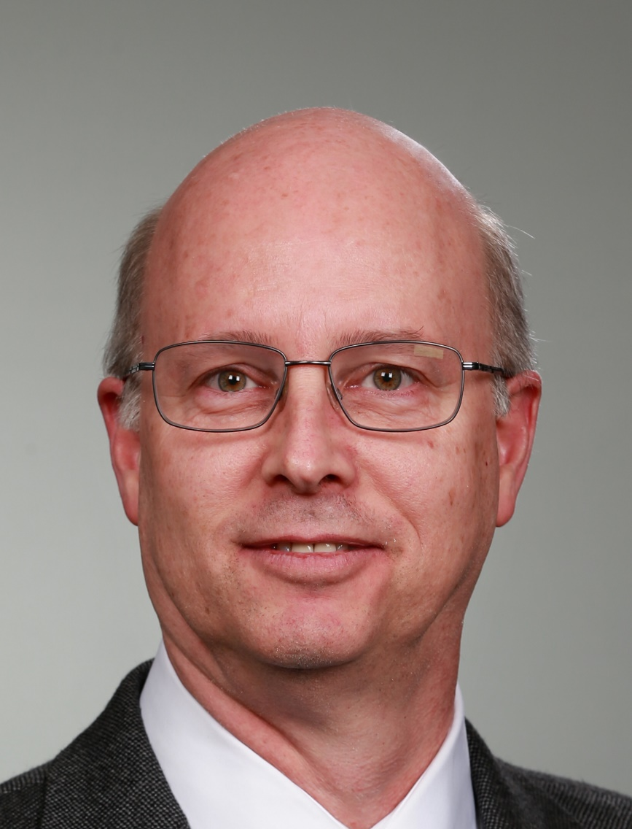
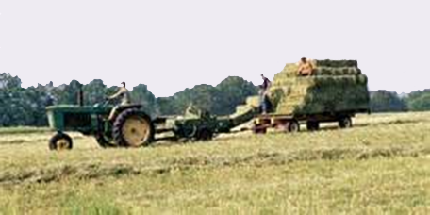
Who is David Smart?
Born and Raised
  Waterloo, Iowa
A “City” boy
Occasionally on loan
  as a young teen to an uncle as a farmhand.
Notes:
That wasn’t a picture of me stacking hay, but it is one of the things I did back then …

Slide 3
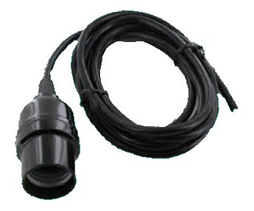
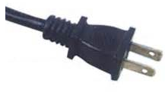
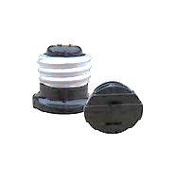
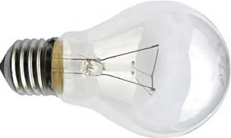
Who is David Smart?
I discovered electricity
at early age.
I think I was about 7…
  “Dad, what will happen
  if I put my thumb
  in there?”
  Dad replied, “Try it.”
  Electricity has been fascinating ever since …
Notes:
We had something like this for an extension cord in the garage. You screw in the small adapter and then you can plug in an electric drill. Unscrew it and screw in the bulb and it takes on another role.

Slide 4
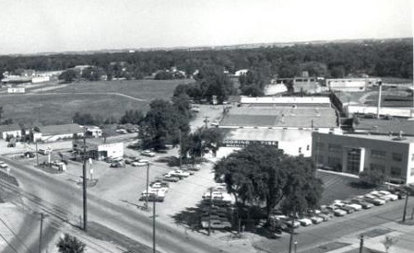
Hands-on [Age ~8 to ~12]
Dad was the hands-on partner in a local machine shop
They created a lot of “tools” for many companies, including John Deere
I and my brothers had nearly free-run [on Saturdays]
  Cutting [anything]
  Bending [metal]
  Drilling [anything]
  Welding [very poorly]
  Melting [lead]
  Pouring molten [lead]
  Turning [lathe work]
  Electrical Wiring [relay logic]

Slide 5
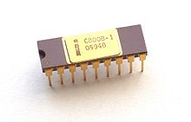
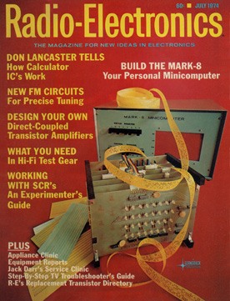
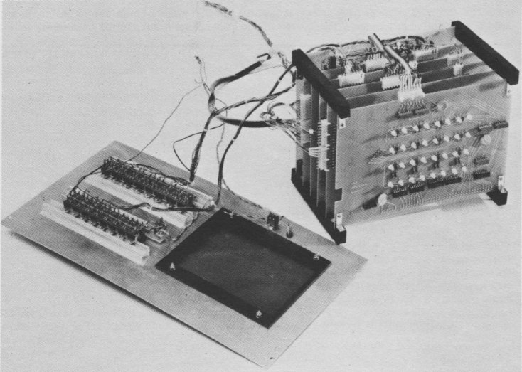
1974 Microprocessor – i8008
Notes:
I was at Hawkeye Technical School (now Hawkeye Community College). Some of the 2nd year students built a couple of these over the summer, and then they graduated and left. Even before any official “programming” class with them, I was permitted to borrow one over the Christmas break. I think I had more fun with this than with anything else I might have received that year.
No non-volatile memory, so on every boot, you start entering the program [a switch for each of the 8 data bits + a switch for <store and advance to the next address>. There was also a switch to “store into high-8 for address and store into low-8 for address, but I think this think only had 1 K of memory and a bunch of LEDs.

Slide 6
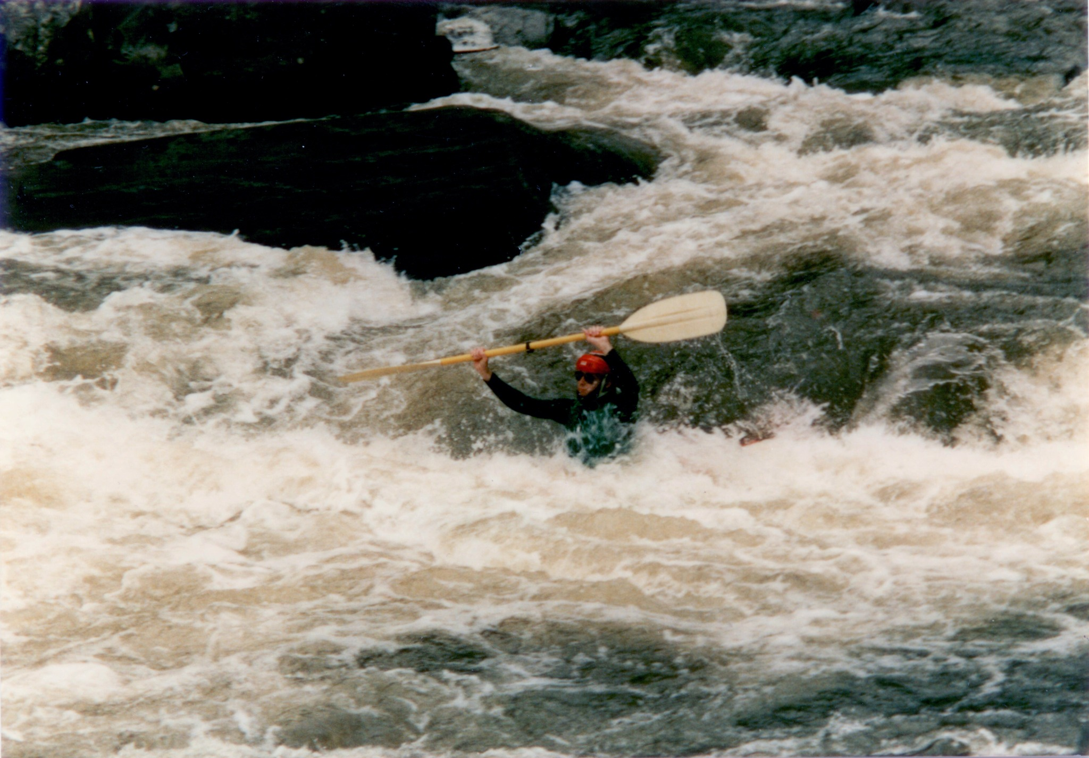
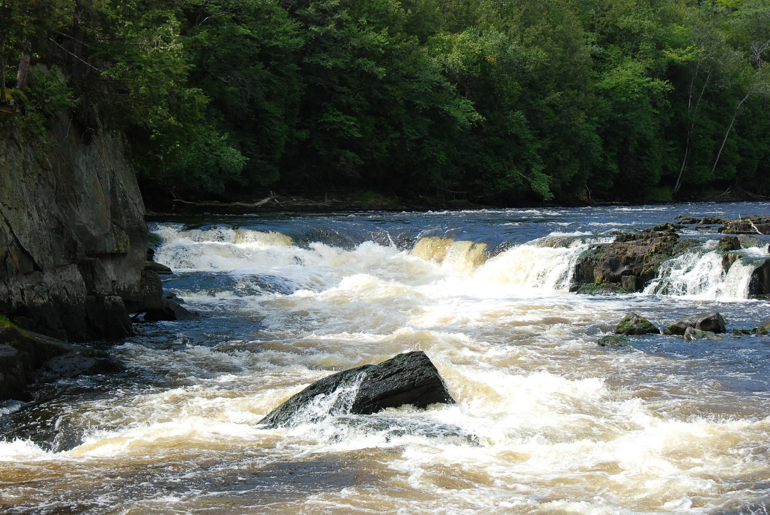

Who is David Smart?
Favorite Hobby – Whitewater Kayaker
  1977: First Whitewater Canoe Adventure
  1978: First Whitewater Kayak Adventure
  Memorable high-adventure rivers
    Ocoee (Tennesee): Site of 1996 Olympics
    Chatooga (Georgia)
    Arkansas River (Colorado)
    Menominee (Michigan)
    Nantahala (N. Carolina)
  Now retired to flat-water
Notes:
Starting in my late teens and for many years after, whitewater boating became my favorite sport. These are pictures from some of the rivers I’ve paddled with two close friends.
For those that remember the movie Deliverance, I and my buddies have paddled 2 of the 3 rivers they used for that movie.
It was about a year after the summer Olympics was in the US that we paddled the Ocoee River – through the stretch where the whitewater Kayaking event was held. That was hair-raising, as it’s very difficult to practice for that while living in the flat-land of Iowa…

Slide 7
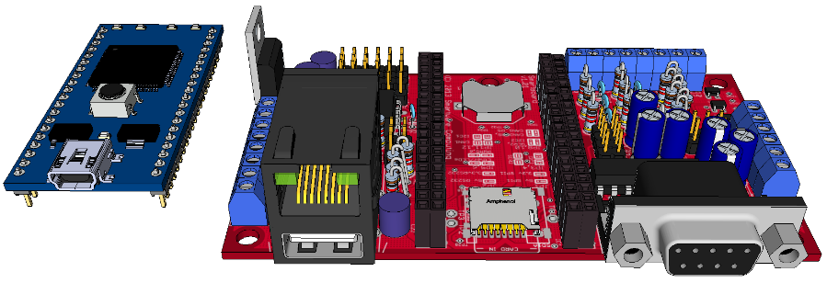
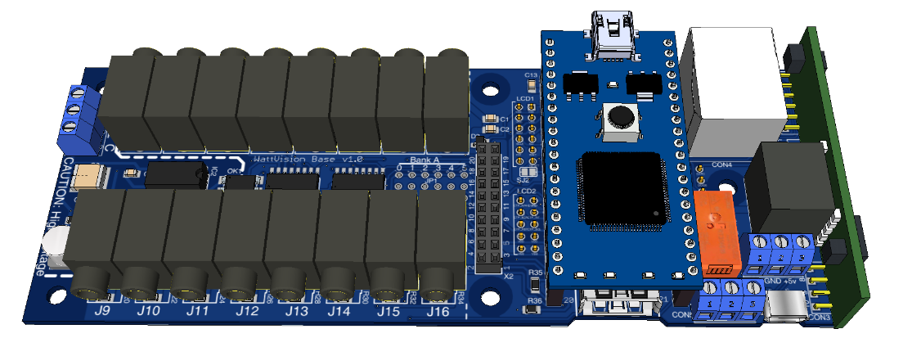
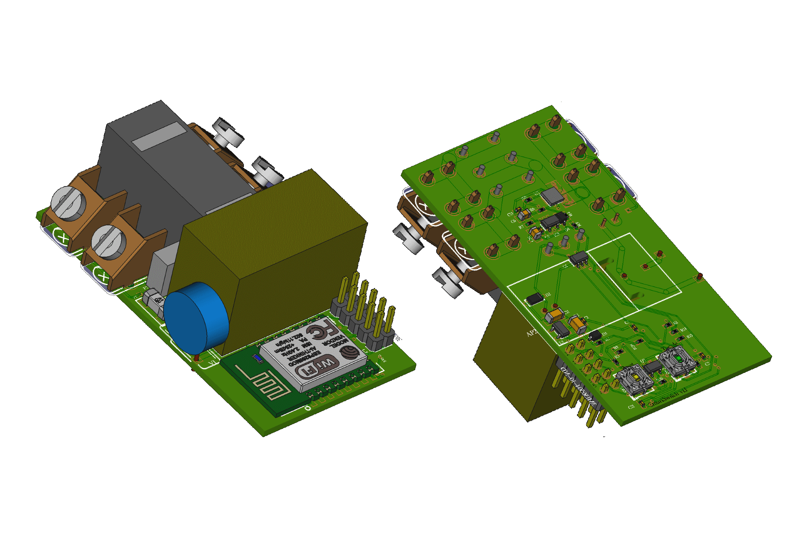
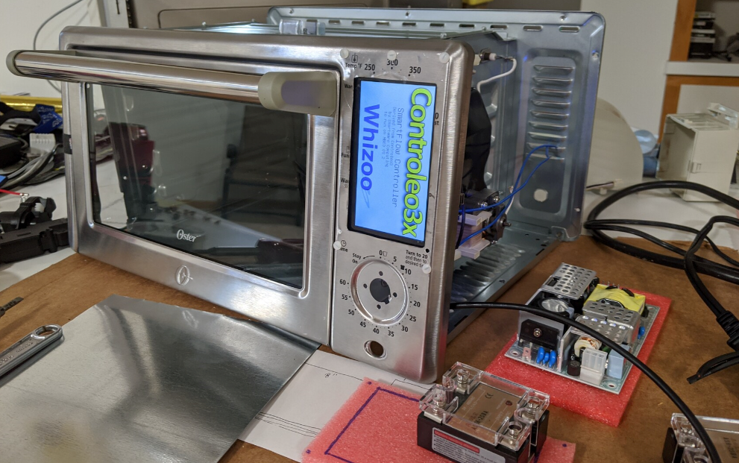
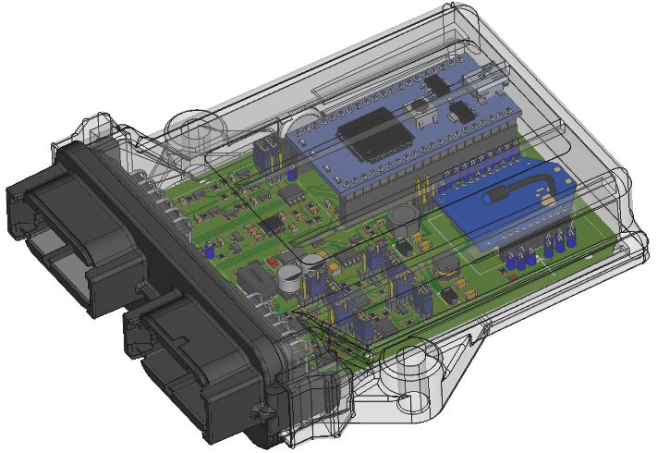
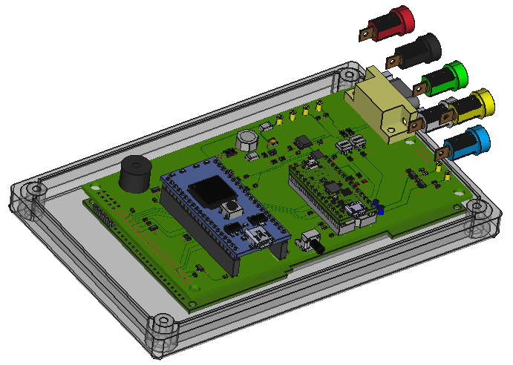
Electronic Hobby
Notes:
What can I say, I have fun with electronics in my home lab – a few of the things I’ve created (most pix are “3D models, but I’ve built one to many of each of these).

Slide 8
David’s Background at John Deere
1979
  Hired into Tractor Electronics
Electronic Design
Software Development
Software Architecture
Specialties
  Instrument Clusters
  Chassis/Body Computer Software
  John Deere Operating System
  CAN Network
  ISOBUS (ISO 11783 Network)
More recently
  LIN, CAN-FD, Ethernet
  Ag Electronics Standards Work

Slide 9
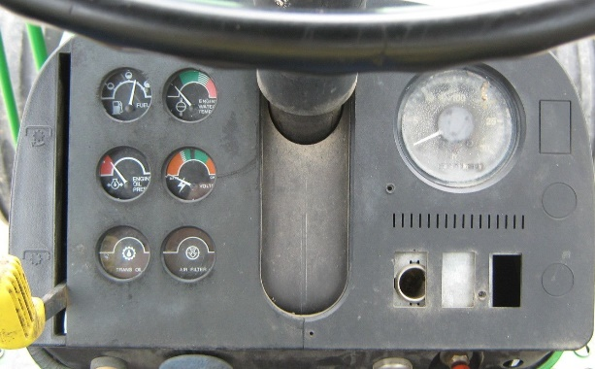
1970s – 1981: No “Electronics”
40 Series Tractor
Notes:
It is hard to find good pictures of equipment back then.
Electrical Gauges on the left. Mechanical tachometer on the right.
The PTO engagement (on the left) was a mechanical system.

Slide 10
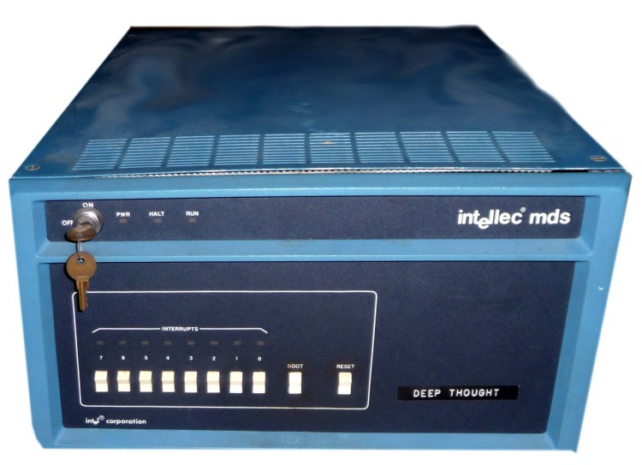
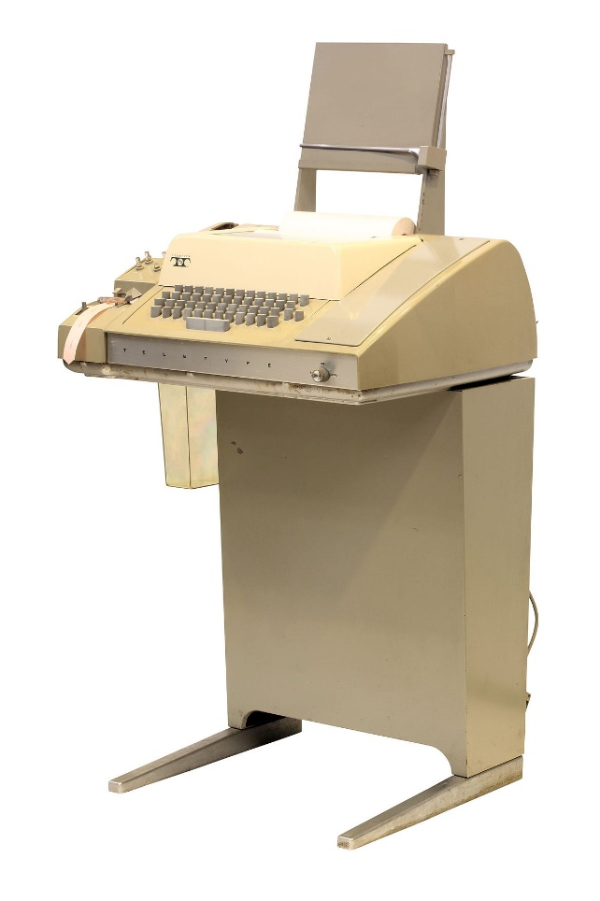
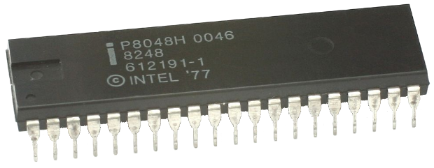
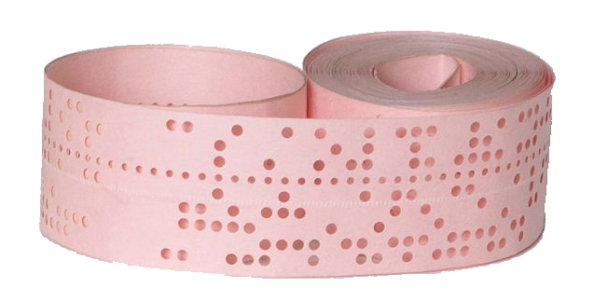
~1980: Development Tools
Intel Corp.
Micro. Development System
Notes:
Typical of what the JD SW developers were beginning to use in the 1980’s.

Slide 11
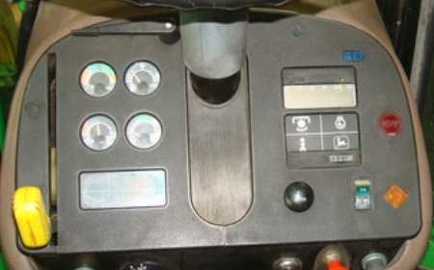
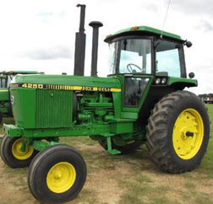
1982: SMU and Digital Tachometer
50 Series Electronics
Notes:
The Standard Monitor Unit (on the left) and the Digital Tachometer (on the right) were the true electronic based products put in production …
The “Standard Monitor Unit” (SMU) on the left was a “custom electronic device” with analog IC and formed-in-place resistors and capacitors placed on a ceramic substrate (think PC Board only ceramic instead). No Computer, No software. “Trimming” the zero and span for the gauges and alerts was done by sand-blasting the resistors that were formed on the ceramic substrate.
The Digital Tachometer on the right had an Intel 8048 single chip microcontroller. Programming was in assembly, but that was pretty easy because it only had room for 1 K of program ROM(read only memory), and 32-Bytes of RAM(random access memory). The 3-buttons let you display the PTO speed, Engine speed, and Wheel speed. The ROM was too small for a 4th function (where the logo is). This micro also “pulsed” an electro-mechanical hour meter.

Slide 12
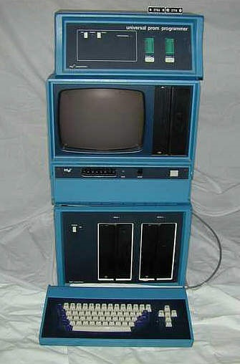
~1983: Development Tools
“Advanced” Development System. We had a very few like this and many of the prior version.
Intel Intellec MDS-80
Prom Programmer
[UV Eraser not shown]
Glass Teletype / CPU
[Emulator Adapter not shown]
Dual Floppy
Keyboard
Notes:
A “Workstation” for developing SW. In today’s dollars, I think this setup cost nearly $30,000.

Slide 13
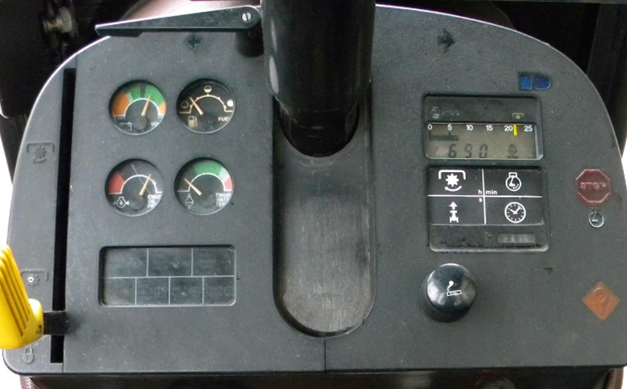
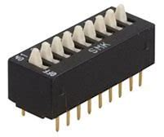
1983: Digital Tachometer with Clock
CMOS Tachometer
80C49
ROM: 2K
RAM: 128 B
[DIP Switches]
Assembly Language
Notes:
The first version I had more than superficial involvement with – The Standard Monitor Unit (SMU) on the left is unchanged from the prior generation.
The Digital Tachometer was the big change. While “true” to its predecessor, this one saw the introduction of an always-on CMOS processor, and the software updated hosted the time-of-day clock function. It was also granted more memory (from 1K to 2K ROM and from 64 bytes RAM to 128 bytes) to host the extra functions. I designed the circuit, and then wrote the code while our suppliers (Motorola and Magnavox) did the PCB and manufacturing. [Back then, we require two suppliers for every design]
When installed, the tach was “programmed” – with a Dual Inline Package (DIP) switch. One switch to pick “mph” or “km/h”, and the other 7 were set based on the tire size for more accurate ground speed.
It also supported some very primitive diagnostics communications with the Engine Control Unit (ECU) and with an electronic Hitch Control Unit (HCU) and an electronic Transmission Control Unit (renamed to P for Powertrain because 7-segment displays could show PCU). So, the Digital Tachometer could show Diagnostic Trouble codes. I think the ECU had something like 14 possible codes. The Hitch and Transmission programs were not advanced to production.
Oh, and the communication link from the ECU to the Digital Tach was 20 baud. As in 20.0 bits per second. Or compared to CAN, this is 0.020 Kbits per second. In Ethernet reference it would be 0.000020 Mbits per second. Really slow…
And keeping accurate time of day is quite a challenge. Aside from “power” management, crystal accuracy is paramount. Unlike a watch worn on your wrist, which experiences a generally very limited temperature range, the -40 to +85°C range is hard to compensate for. We did not include a crystal “oven” for temp stabilization – too much power draw.
In the 80’s electronic engine controllers first appeared – but I don’t recall just when. We had experimental ECUs, Transmissions, and Hitch electronic controllers, and first experimented with a diagnostics link to a version of this digital tachometer to show DTCs.

Slide 14
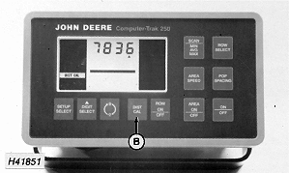
~1985: Performance Monitor
Variations of this were created in the 80’s for tractors, balers, and more…
Notes:
I did not work on this exact one, but I could not find a picture of a “Perf-Trak” or the “Shift-Trak” performance monitor that I did program. We used the same housing, same button layout but with a different LCD and front panel labels. The mounting bracket was also bit different; it was curved, to fit the top of the dashboard (as seen on the previous screen showing the Digital Tachometer).
I inherited the base code – for a simple performance monitor and added the functionality for a “Shift Advisor” – to try to get customers to use the optimal gear and engine speed for a given load.
Code was still purely in assembly, but what was kind of unique – this product maintained all the internal data in BCD (Binary Coded Decimal) format, not binary. So, all the math was BCD math – executed in the same style as “long-hand” multiplication and division.

Slide 15
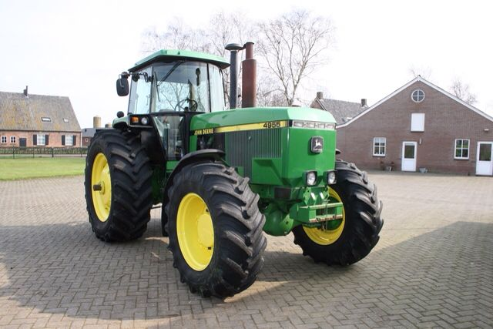
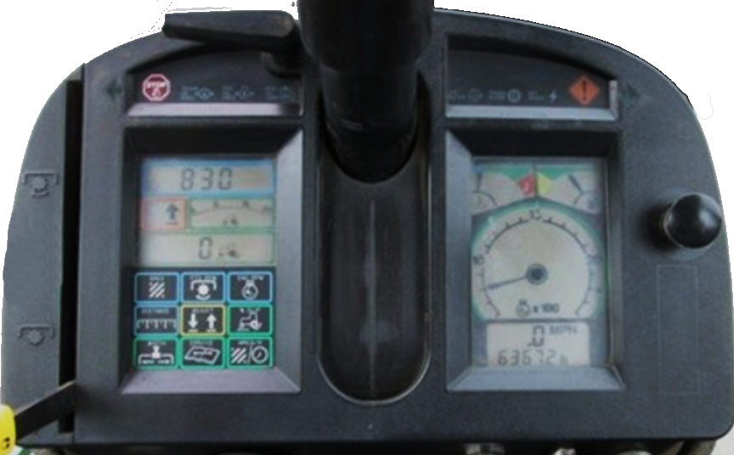
1988: IntelliTrak (First “Network” in production)
55 Series, 60 series
Perf Mon + Tach
68HC11A8
2 MHz
8 K Masked ROM
256 B RAM
512 B EEROM
CCD Network
Assembly Language
Notes:
Now we’re advancing into the modern age! Advanced Performance Monitor on the left and Advanced Tachometer and System Monitor on the right.
Departing from the Intel microcontrollers, the two modules shown here had Motorola 68HC11 microcontrollers in them. The early version had an 8 Kbyte MASK ROM. From the “final” software to the first chip there was a 26-week lead time, and a $25,000 Mask ROM charge. So, you wanted it to be right. A later version of this expanded to a 12K ROM.
This pair of modules had the first “Network” that John Deere put in production – CCD (Chrysler Collision Detection, later renamed to SBI – Serial Bus Interface. You can find the chip spec as CPD68HC68S1). The network connected only these two modules and was our “pilot” evaluation before expanding to include other electronic controllers. If disaster had struck, we could have replaced the network with a TX/RX pair of wires.
The Performance monitor on the left and the Tachometer on the right shared the same hardware design and PCB, with only component changes for the two front panels, and of course – Software. Various signals were then shared across the network – engine speed, ground speed, radar speed, PTO speed, and so on.
I and another engineer designed the circuit. And then I wrote the code – Motorola 68HC11 assembly language.
To develop the network software, I needed “network analyzer” software. But this chip was too new, no such thing existed. So, I self-learned C Programming (directly from the K&R book) and with a Microsoft C compiler, and created a program called CCDWin (CCD Window). In 1988, Microsoft Windows wasn’t ready for prime-time, so this was a pure DOS program, but with pull-down menus, dialog boxes, and other interesting behaviors. Sadly, CCDWin does not run under Windows 7 or newer, so it is hard to demonstrate what life was like back then …
Because of the network, the embedded device had a special manufacturer test interface, so the PC could send commands to read or write inputs and outputs for testing. I also added code to turn on/off individual segments on the LCD to ensure it was functioning properly.
When we received the very first production version of this tachometer, with MASK ROM chips, it was a pretty big deal. Back then, a MASK ROM cost $25K and had nearly a 26-week lead time. It had to be right! Several managers were huddled around, looking over my shoulder at the tachometer. As I turned on power, they didn’t notice as I also reached for the desktop computer, activated the test code, and sent a pattern to the display that said “hi dAvE” on the 7-segment display. Amid the shock, horror, and outrage that every tach would do this on power-on, I thought I was about to lose my job. One manager was rather vein-bulging red-faced and wouldn’t let me even get a word in edgewise – to tell them that this was test code in the PC, not in the product. Eventually things settled down – but too late – I was scarred … Ah, but I didn’t lose my job…

Slide 16
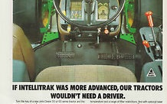
~1988: If Marketing knew then what we know now …
Notes:
While searching for good pictures of IntelliTrak, I came across this advertisement.
In light of our GPS based guidance products, this was entertaining for its time.

Slide 17
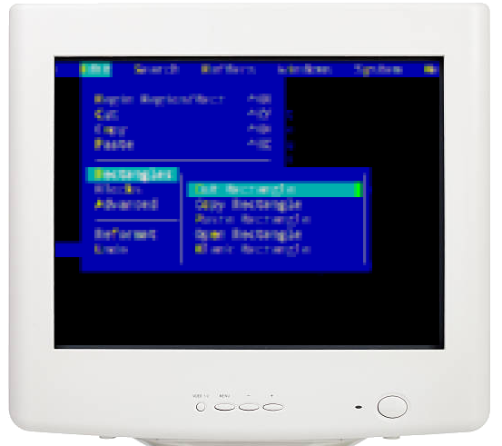
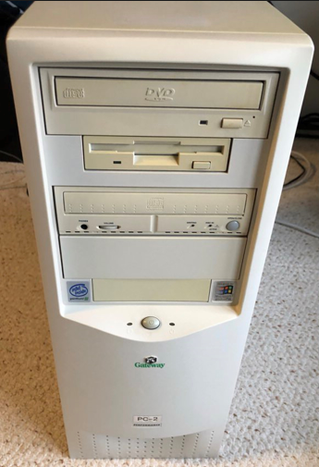
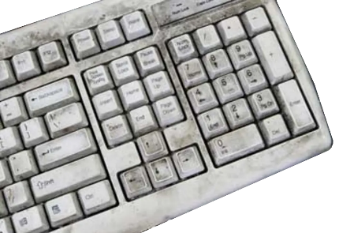
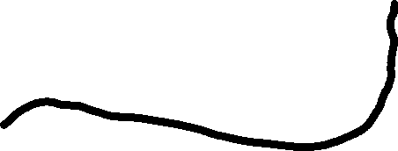
~1988: IntelliTrak (First Factory Programming)
Notes:
In prior generations, simple Dual Inline Package (DIP) switches were used to calibrate for tire size and ground speed units of measure. These devices would have required many more sets of switches for various options. EEROM on the 68HC11 micro was used instead. Through a [then] elaborate mechanism of the headlight switch, hazard switch, and the turn signals, all of this could be configured from the cabin. But for the factory we created a better way. I led the development of a PC-hosted application that factory programmed the settings into the ECUs via the network interface.
Again, still in “DOS” (not Windows), but with an intuitive menu system (for its day), the factory worker needed only the arrow keys, <enter> and <escape> to pick from lists, and number pad for the vehicle serial number. The program walked the operator through the settings list for tire size, units of measure, fuel tank size, turn-signal behavior, 2 or 4WD settings, and several other parameters.
And the factory PC was only as clean as this example – on the first day. By day two, I brought my own keyboard from the office when it needed a little engineering help.

Slide 18
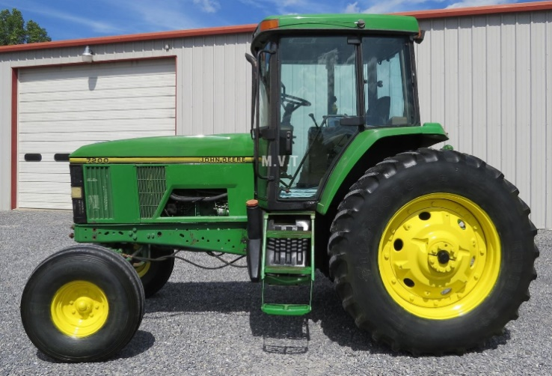
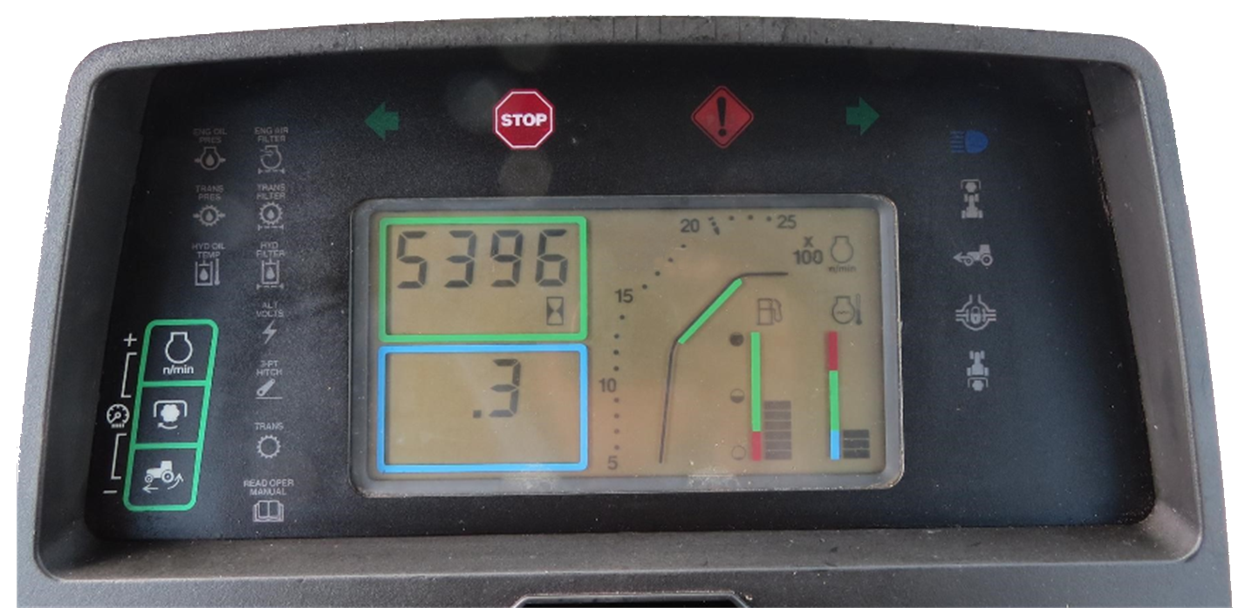
~1992: Digital Tachometer (First 100% “C” Code)
Tachometer
8051 Variant
8K OTP ROM
256 B RAM
256 B EEROM
CCD Network
100% C
12K ROM
Notes:
Having taught myself C programming on the PC, to create the network analysis tool, CCDWin, I wanted to apply this newfound knowledge to a product. The digital tachometer shown here contains the first 100% C program John Deere put in production and it was 100% from me.
The initial version of the microcontroller was a CMOS version of an Intel 8751 derivative with 8 KByte of OTP – One Time Programmable memory but proved to not be enough. C compilers were less efficient than assembly, and there was a lot of functionality beyond the prior generation product, along with a different micro architecture. We needed to upgrade to the 12K version.

Slide 19
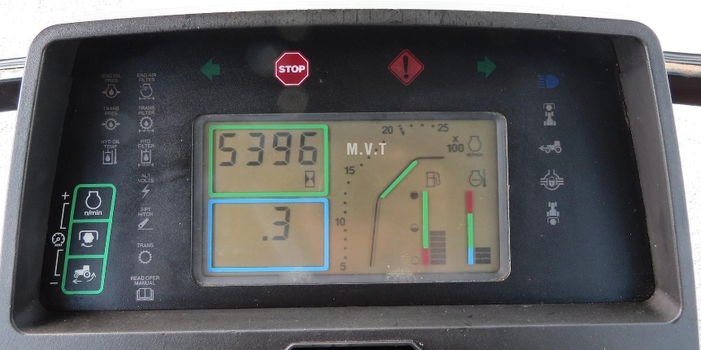
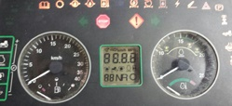
~1992/3: Analog Tachometer
Tachometer – Analog
8051 Variant
12K OTP ROM
256 B RAM
256 B EEROM
CCD Network
100% C
~ 80% code reuse from Digital
Notes:
As an alternate to the digital tachometer, there was an analog version in the same form-factor. This was as close to a “good” picture as I could photo-merge together.
Derived from the digital tachometer software, this too was 100% C code, and shared about 70 % of the code from the digital tach. Another SW engineer started with the digital tach code base, but I soon took over and finished the product.

Slide 20
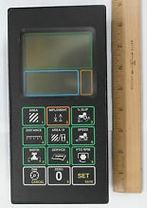
~1993 Performance Monitor
Perf Mon
8051 Variant
16 K OTP ROM
512 B RAM
2K SPI EEROM
CCD Network
100% C
Notes:
The Performance Monitor shown here was a companion to the Analog/Digital Tachometer. This was the 3rd 100% C code in production device. I think this may have had 16K of program space and we were using One-Time-Programmable (OTP) parts as I recall.
The development time for the software for all three of these devices (Digital Tachometer, Analog Tachometer, and Performance Monitor) took less time than a single software development cycle of this complexity using assembly language, and the defect rate was much lower – although we didn’t have much in the way of defect tracking back then…
This was a unique project for me in that I was very heavily involved in the electrical design and PCB layout, the LCD design and layout (including the displays on-glass circuit layout), the touch panel layout (and its circuitry), and the software. Having designed the touch panel, I paid more attention to the backlighting than any other device of that era, and for many years after. I took care in how the backlight cast shadows onto the panel and legend to ensure it was easy to recognize the button functions.
With the great accomplishment of completing three projects in about the time of one (yes, about 3 x faster than similar projects), I still came away with some scars… The C-compiler of the day was not as efficient as carefully crafted assembly. That pushed the code size over 8K for the tachometers, and into the 12K version of the micro. That 12K part cost $3 more per unit. The electronics engineering manager in charge at the time let me know that $3, multiplied by the estimated annual production, totaled far far more than my annual salary. The reduced non-recoverable engineering (NRE), and single engineer, was not part of the equation for “success”, only piece-part cost counted. I had a few more scars from this, even though I somehow felt justified.

Slide 21
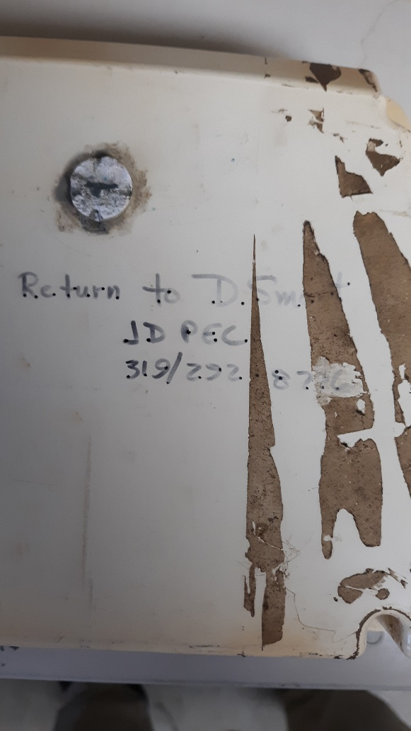
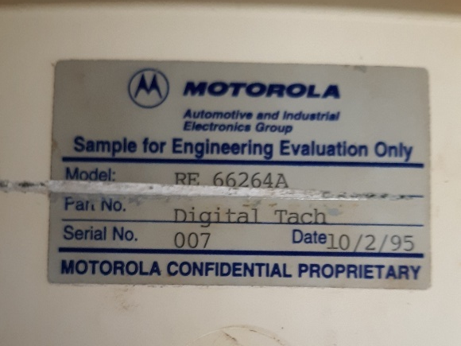
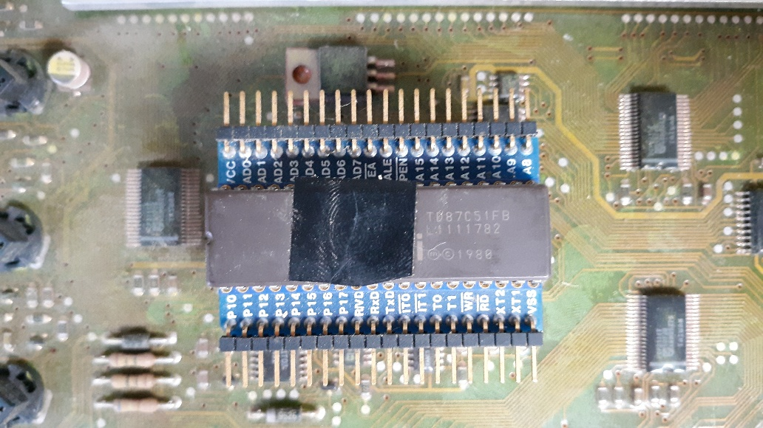
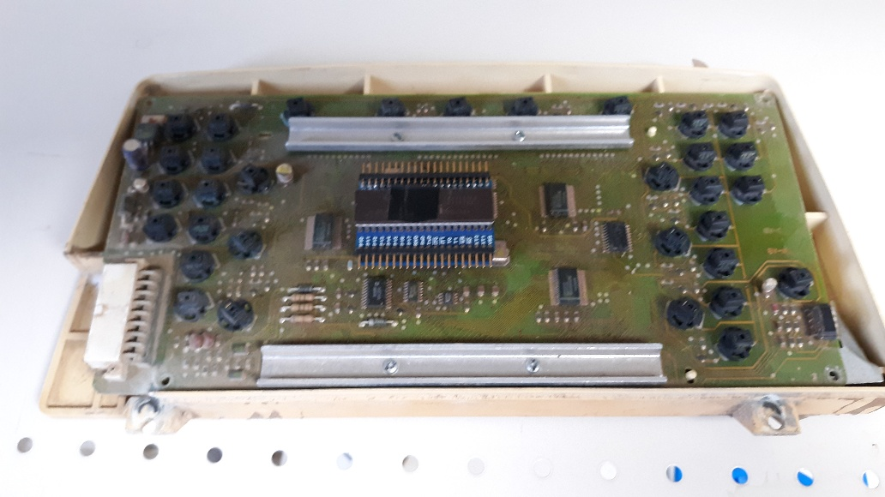
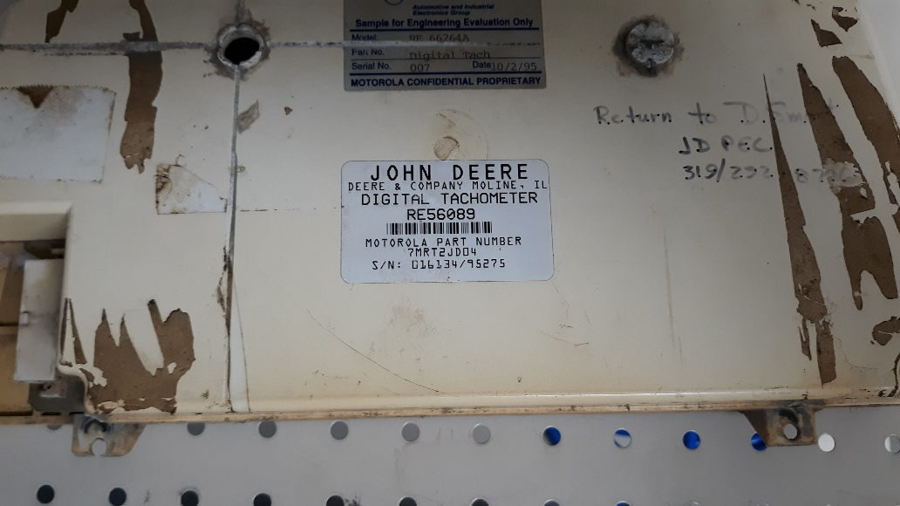
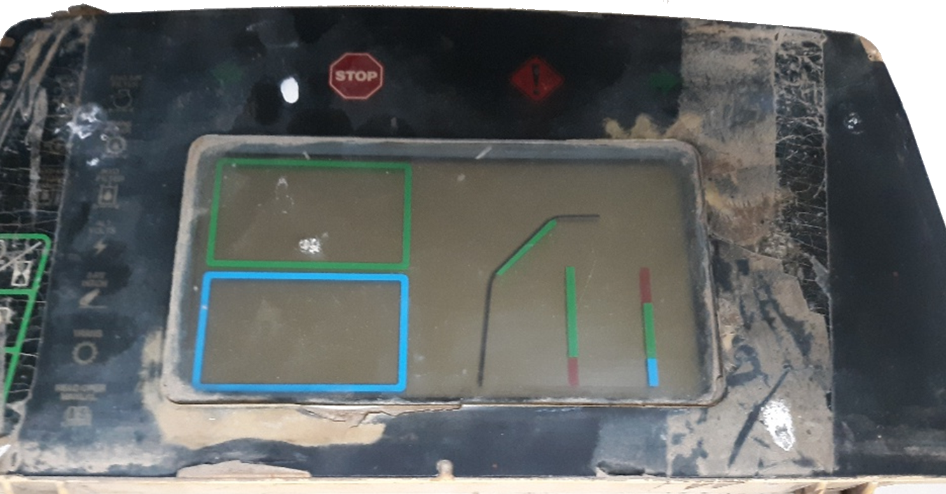
~25 Years Later
Notes:
There’s a bit of a story here, best told, not read. But the short form is – 25 years later, I got a call from some Tractor bone-yard in Pennsylvania. They left me a confusing message I could not understand, so ignored it. A week later they tried again. While scrapping one tractor to make another run, he came across this tachometer that didn’t work. He turned it over and saw the label on the back, “Sample for Engineering Evaluation Only”. And over to the right was my name and phone number. He was asking if he should send it back to me. I thanked him for calling, suggested it had served its useful purpose and if he could take a few pictures of it I’d appreciate that. Here inside was a UV erasable 8751FB, with tape over the window. I can’t help but to wonder – is that thumbprint mine?

Slide 22
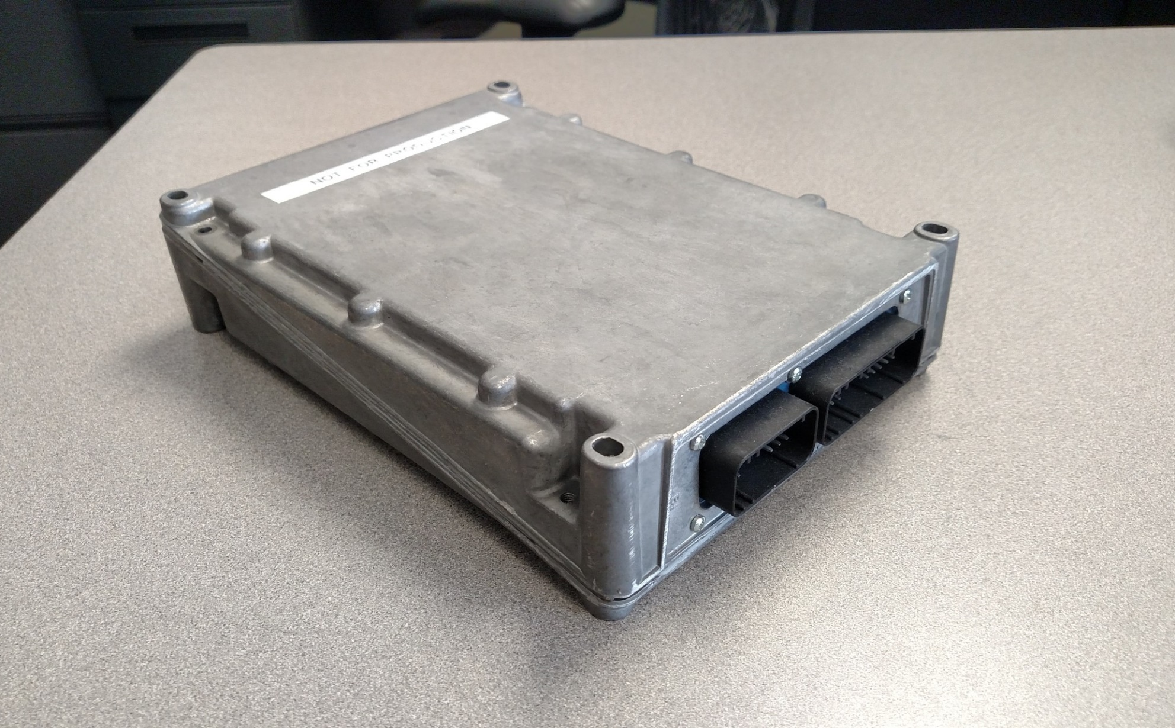
~1995: Chassis Computer (First Factory Programmable ECU)
7000 Series tractors
Chassis Computer
68HC11E12
2MHz
8K EEPROM (Factory/Field fully Programmable)
512 B RAM
512 B EEROM
CCD Network
Assembly + C
Derived from Assembly Lang. IntelliTrak
All new code was C.
“Task Scheduler”
Notes:
Basic body-functions – PTO control, lighting control, speed, temperature, filter sensor monitoring and reporting.
This was derived from the 68HC11 in-dash Digital Tachometer from 1988, sharing much of the same code. The code was still assembly, but modularized quite a bit to support many the new functions. This version had a primitive “Task Scheduler”, where more typical of the day (and every other JD product) was a for ( ; ; ) loop.
In ~1994, some additional functionality was brought into this module from the trio – Digital Tach, Analog Tach, and Performance monitor devices (which were pure-C). Unique to this was that some C functions were imported into, and called from, the predominately assembly language program and scheduler.
This device was also the first fully field-reprogrammable ECU (over the CCD network) that JD put in production. It had an external EEROM for the program memory. The most “flexible” alternatives to this at the time were UVPROM chips in a socket with a tie-strap to hold it firmly in place. Full reprogramming was used a few times in the Tractor manufacturing line when some enhancements were put in place, but never “in the field” by anyone other than engineers.

Slide 23
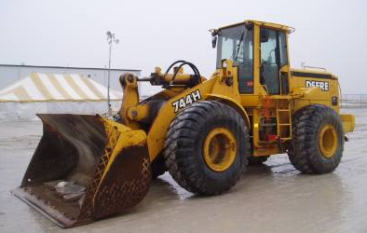
~1995: John Deere Operating System
Application
Component 1
Application
Component 2
...
...
...
...
...
Application
Component N
Task Scheduling
Intertask Data Communication
Power Management
Timing Management
Analog Input
Logic Input
Power Driver
Specialty I/O Drivers
Non-Volatile Memory
Network Comm
Fault Management
Diagnostics
Manufacturer Test
Re-Programming
Transport Prot.
Notes:
In support of an urgent staffing need, David Smart and Jim Phelan were loaned to C&F (Dubuque, IA). Together with Dan Pflieger and Gladys Evans, we created what would later become known as JD/OS. JD/OS wasn’t the “product”, but a necessary piece of infrastructure to support the development of the control software for the loader, while best utilizing the development team.
This started early in 1995, and now more than 25 years later JD/OS is still in most of the embedded control systems in production, but its sunset is forthcoming with the mass migration from 16-bit to 32-bit microcontrollers.
None of us imagined that we were inventing an embedded operating system with a life of 25+ years that was far in advanced of what competitors have had. And this ultimately scaled to the enterprise because of a failed attempt to use a commercial operating system (on which I personally lost over half a year helping the vendor debug it – but to no avail).

Slide 24
JD/OS Factoids
1995 to present (dates shown are approximate)
1995 – 4WD Loader only.
1996 – 90 Series all CAN Combine
1998 – Tractors using both CCD and CAN
2008 – Last CCD network leaves production**
2001 – Deployment into nearly all tractor controllers (excluding engine)
2020 – Sunset pending, with the transition to 32-bit micros
** CCD Support continues: Gen4 Universal for retrofit, ServiceADVISOR™ EDL for diagnostics
JD/OS Factoids
~ 250KLOC (250-thousand lines, excluding the “Application”)
Microcontrollers that use JD/OS
  Sourced from: Infineon, ST, and FreeScale
  Typically have from 750K Bytes to 1.8 MB of program storage
  Have from less than 20K to well over 80KB of RAM
  Run at clock speeds from 16 to over 100 Mhz

Slide 25
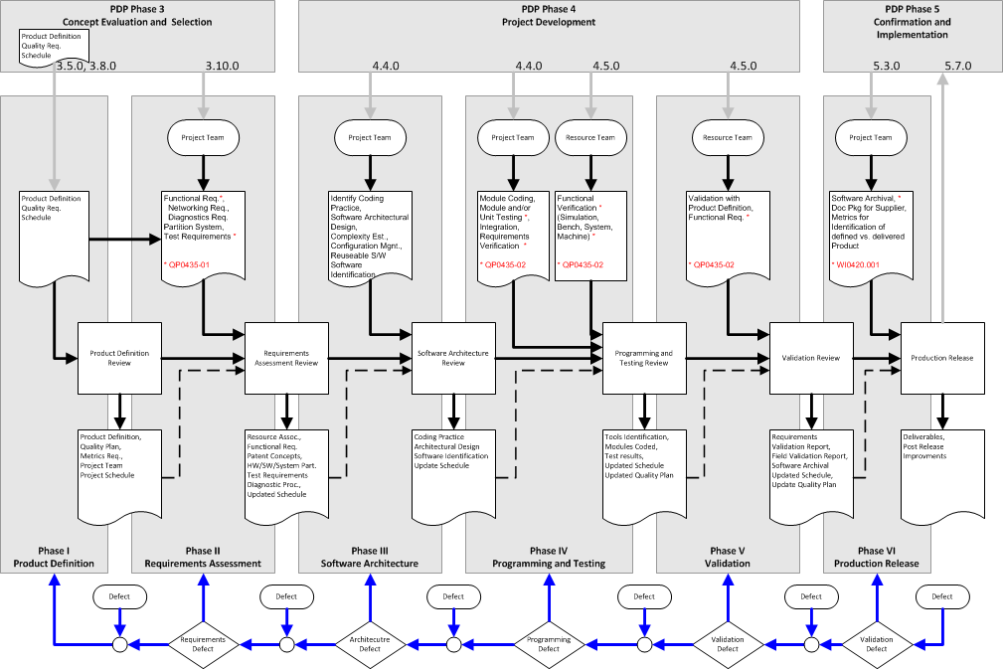


~1997: Software Development Process & Coding Convention
Notes:
Along with the work on JD/OS was a goal to deploy a common Software Development Process. Mapped somewhat to PDP, but perhaps more closely aligned to industry SDPs, the process was executed by many. This was at a time when we were still early in transition from 1 engineer == 1 software project into the territory of >1 engineer for 1 software project, and from only “self-guided” process to a common process.
Along with that, I defined a C Coding Practice, and rolled that out. If you were to compare the current 2020 JD - C Coding Guide to this original work, you will see it is virtually identical.

Slide 26



~2001: Virtual Terminal
Notes:
2001: I joined the tiny Precision Farming (PF) group and relocated to Des Moines Iowa to work on the Virtual Terminal. PF later became Ag Management Solutions (AMS), then Intelligent Vehicle Systems (IVS) and is currently named Intelligent Solutions Group (ISG).
This is what launched my work on the ISO 11783 standards – first to implement ISO 11783-6 (Virtual Terminal), next as a complainer of the quality of the standard, and the reward for that by leading the updates to that part for the following 13 years – eclipsed by my work in AEF on High Speed ISOBUS>

Slide 27

2008: Tractor Update 2008
Notes:
2006: I returned to Waterloo – and one of my early assignments was the integration of a Virtual Terminal into the armrest of every Mid/Large tractor, starting with the 8-series in 2008.

Slide 28












~2010 and since: Enterprise Electronics Group
Notes:
In 2009, and more fully in 2010, the Electronics Systems Shared Services (E3S) was formed. This is now known as the Enterprise Electronics Group (EEG).
I’ve focused on SW Architectures and Networking since then – which you see takes me in many directions from system design to diagnostics and troubleshooting to creating design guidelines, and new architectures.

Slide 29
2018 –
AEF Project Team 10 Leader
  High Speed ISOBUS
  1Gb/s 1-Pair Ethernet to cross-the-hitch
Use Cases:
  Advanced precision farming performance
  Advanced displays
  Advanced automation
  Remote viewing digital cameras
  Interface to Wireless Infield Comm
  And more …

Slide 30
Final Note
My role
  Support and Advance our
  Embedded Networked Systems
  I’m not attached to any EPDP Project
  I am [usually] available to support all needs
  Please engage me me early in design
  Late and Urgent needs are ok too

Slide 31
If I Left Enough Time
Your Name
How long with John Deere
Role, and in what group
What do you
  Know about CAN
  Want to learn about CAN

Slide 32

2020
1 of 7 2020
John Deere Fellows
And the year of
my retirement

Slide 33



Post-Retirement
On contract to JD to continue my work leading AEF HSI
Hobby-business for a few companies
Hobby-fun for my own pleasure

Slide 34

HSI – High Speed ISOBUS

Slide 35

HSI – High Speed Interconnect

Slide 36

HSI – Protocol Map

